Slide 1

Graphic Novels and Creative Writing in the MFL classroom: the case of Marjane Satrapi's Persepolis
Fernando Castellano-Bañuls
Aberystwyth University
fec16@aber.ac.uk
9th Annual Learning and Teaching Conference – 2nd July 2021

Slide 2
Disclaimers
English is not my mother tongue – sorry!
This communication is based on my (unplublished) Master’s dissertation in 2019
The original dissertation dealt with English as a Second Language (ESL)
It has been slightly modified with the purpose of making this communication more useful for other disciplines (ESL > MFL)

Slide 3
questions that triggered my research
How can we incorporate literature in the MFL classroom?
How can we make students read, discuss and enjoy literature in a foreign language?
What will they read and which activities will be proposed around the chosen texts?
Graphic novels
Multiliteracies pedagogies and multimodal texts.

Slide 4
Multiliteracies
Coined by the mid-1990s by the New London Group
A shift in the understanding of literacies → more plural.
Aimed to have in mind:
(1) the proliferation of multimodal ways of making meaning where the written word is part and parcel of visual, audio, and spatial patterns
(2) the increasing salience of cultural and linguistic diversity characterized by local diversity and global connectedness.
(Westby 2010: 65)

Slide 5
Multimodal texts
Need to refedefine the concept of ‘text’
→ Kress - “print-based and digital texts that utilise more than one mode or semiotic resource to represent meaning” (Serafini 2015: 413).
Graphic novels
- Images
- Text

Slide 6

Graphic novels
Defined by Will Eisner
“a form of sequential art, often in the form of a strip or a book, in which images and text are arranged to tell a story” (Paglairo 2014: 33)
Images are the text
Images cannot be read in the same way as texts
No communication is achieved unless comic readers know how to read the meaning that the arrangement of panels imply (Pagliaro 2014: 34)

Slide 7
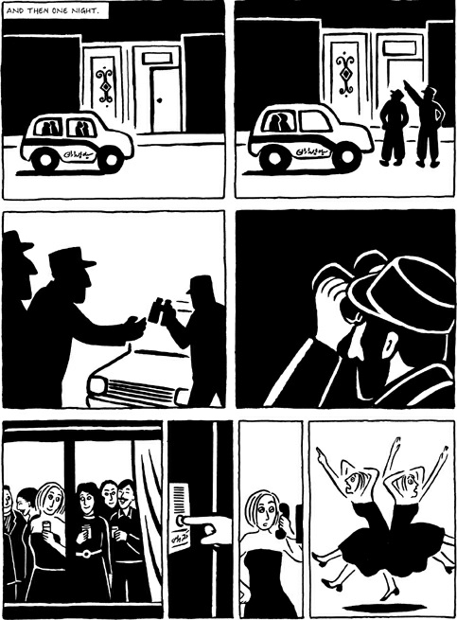
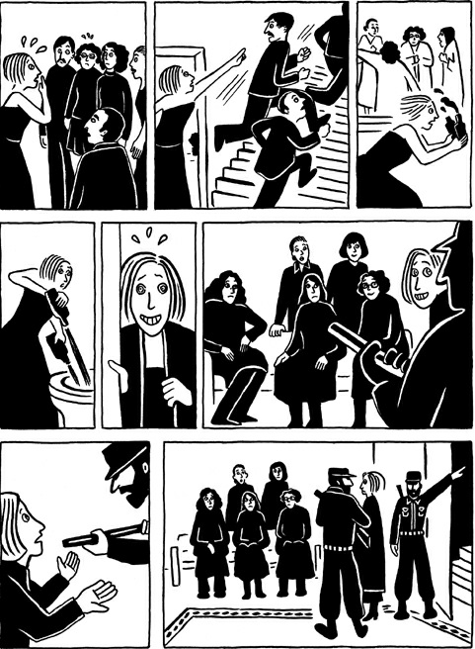
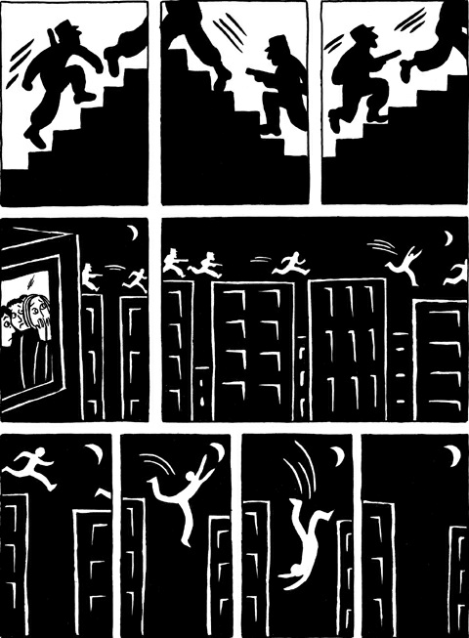
Marjane Satrapi’s Persepolis (2000)

Slide 8
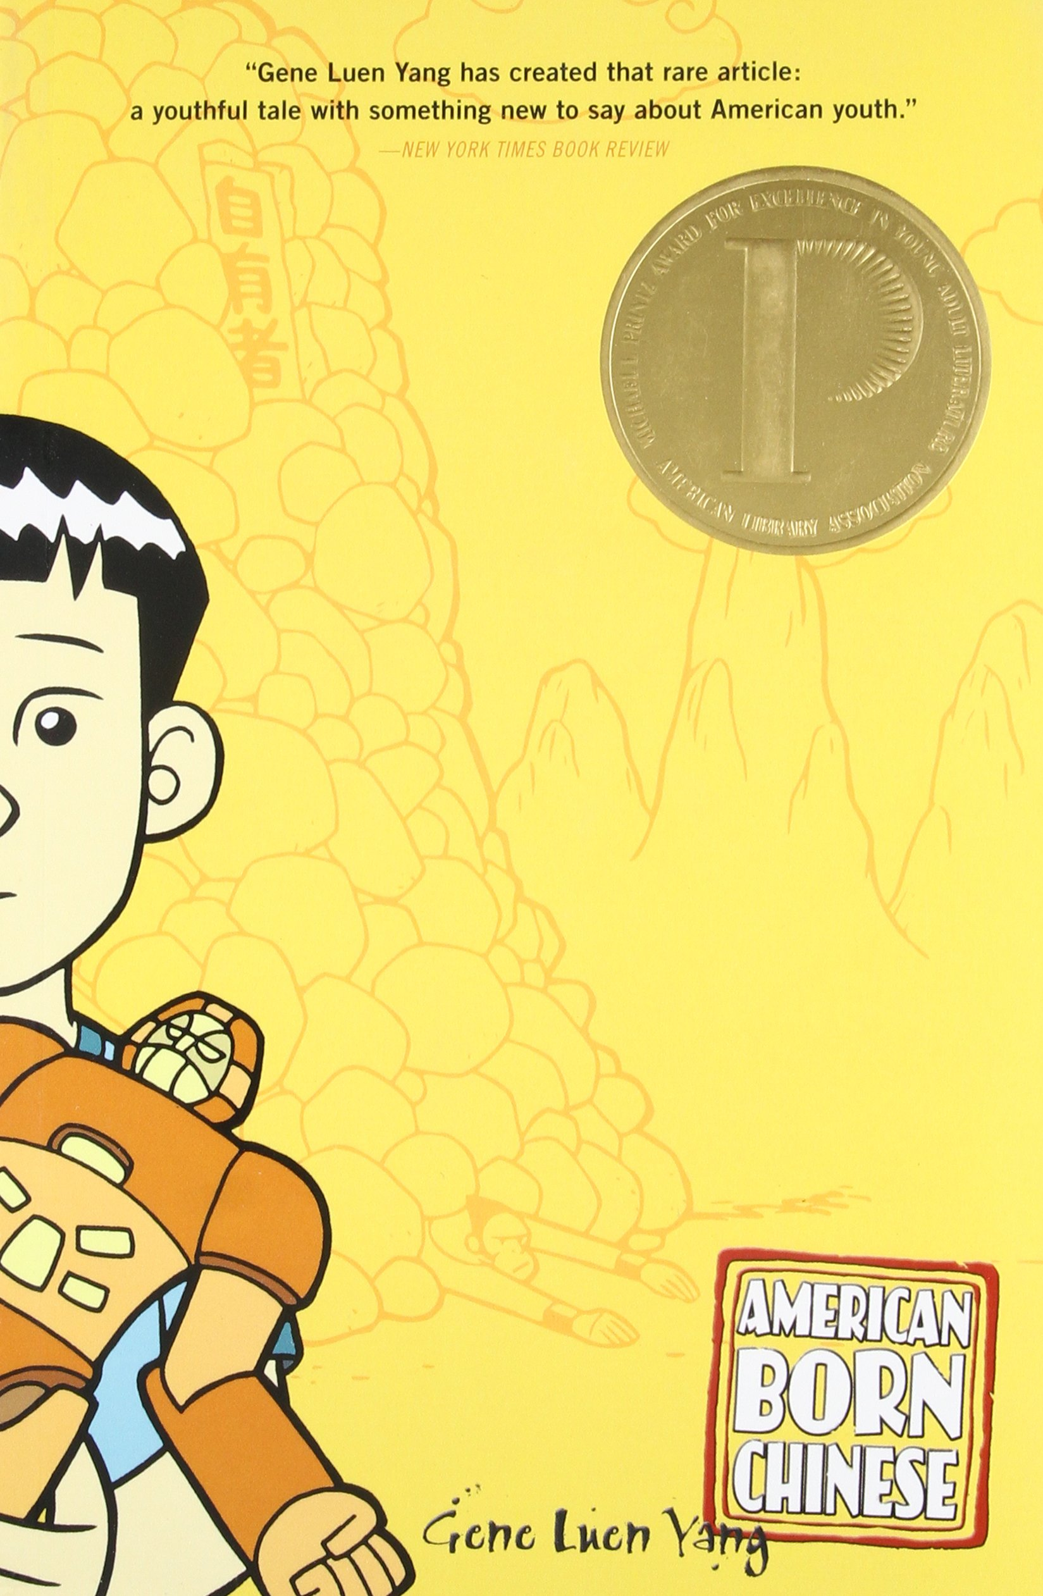
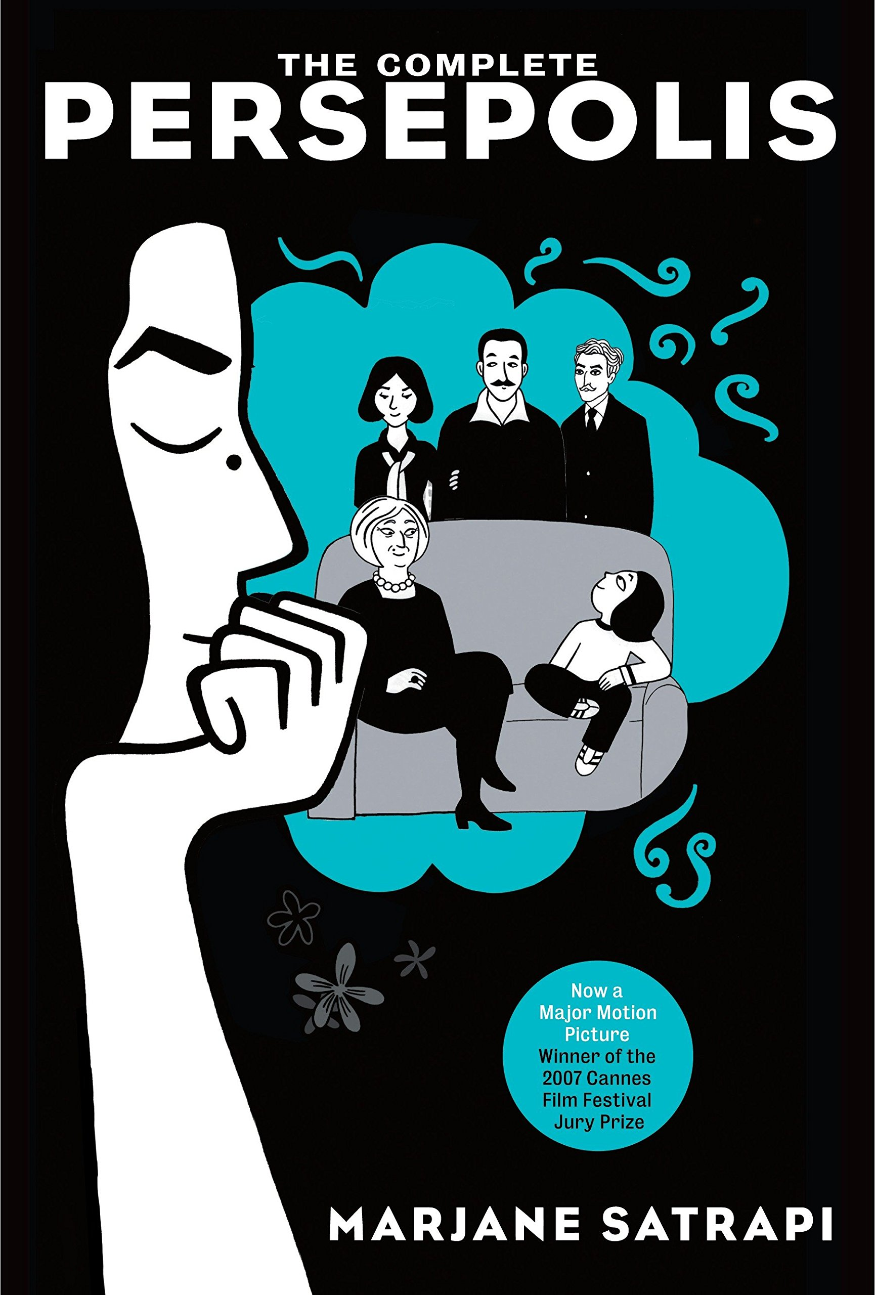
Multiliteracies → ‘a dynamic understanding of literacies as a multiplicity of discourses (Lange Guerra 2017: 9)
Graphic novels can also reflect on non-Western discourses and experiences.
→ Students from other cultures in our class might see their experiences authentically and respectfully portrayed in the texts

Slide 9
Creative writing
Very much linked to the concept of multiliteracy, identity, empowerment and motivation.
Krashen’s Affective Filter → attitude or motivation towards the language (Clavel Arroitia 2012: 64)
Focusing on students discourses (creative productions) should bring the affective filter down and facilitate the acquisition of languages.

Slide 10
Main questions and hypothesis
Research questions
Hypothesis
How can students work with literature in the MFL class and engage with it playfully?
How can multimodality help students engage with foreign languages and literature?
Can creative writing and literature motivate students to learn MFL?
Through the combination of literature, multimodality and creative writing, students can improve not only their L2 skills but also their attitude towards the class and the language.

Slide 11
Methodology
How to make students work with literature.
Pieces of literature selected carefully
Information kept at a mínimum (author’s bio, historical contexts….)
A response is needed
  Review?
  Essays?
  Creative piece → increase their motivation
Persepolis Project → Make students read excerpts form Marjane Satrapi’s Persepolis and make them create their own graphic novels.
Topic: why am I learning MFL? → why am I studying this course?

Slide 12

Context and subjects of the study
IES Jordi de Sant Jordi. València, 2019.
Two adult groups (Apprentenships), 23 people.
  G1 - TIS (Técnico de Integración Sociocultural)
  G2 - TASOC (Técnico de Animación Sociocultural)
Heterogeneous groups in terms of age and origins.
Target language level - B1 (allegedly).

Slide 13
Lesson plan proposal
Students read Marnaje Satrapi’s graphic autobiography. We comment on class.
Students create their own graphic autobiographies – they tell their own stories. We give them class time and support
Students present their creations
Contribution of the project to the total mark of the subject – 20% (10% the oral presentation and 10% the project itself).

Slide 14
Lesson plan proposal
G1 |  | G2
27/2 | Presentation of the project to the students | 4/3 | Presentation of the project to the students
1/3 | Reading The Veil + Kahoot | 5/3 | No class
6/3 | Reading The Sabbath | 12/3 | Reading The Veil + Kahoot
13/3 | Writing class | 19/3 | No class
20/3 | Writing class – last day for corrections | 26/3 | Writing class - Last day for corrections
27/3 | Hand in the project and oral presentations | 2/4 | Hand in the project and oral presentations

Slide 15
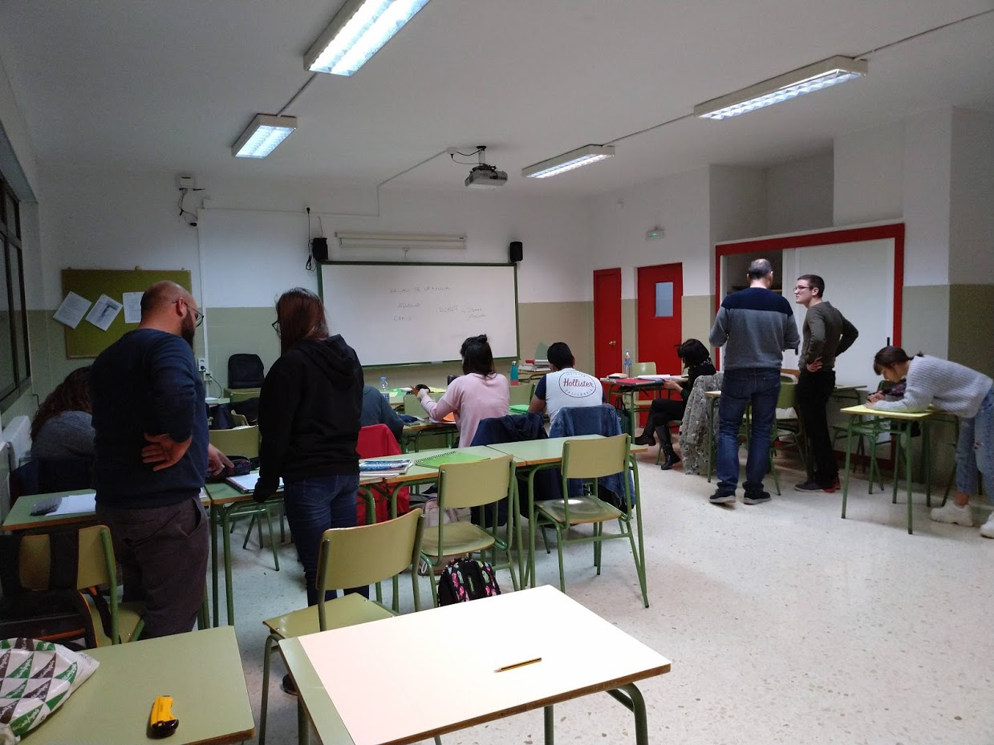
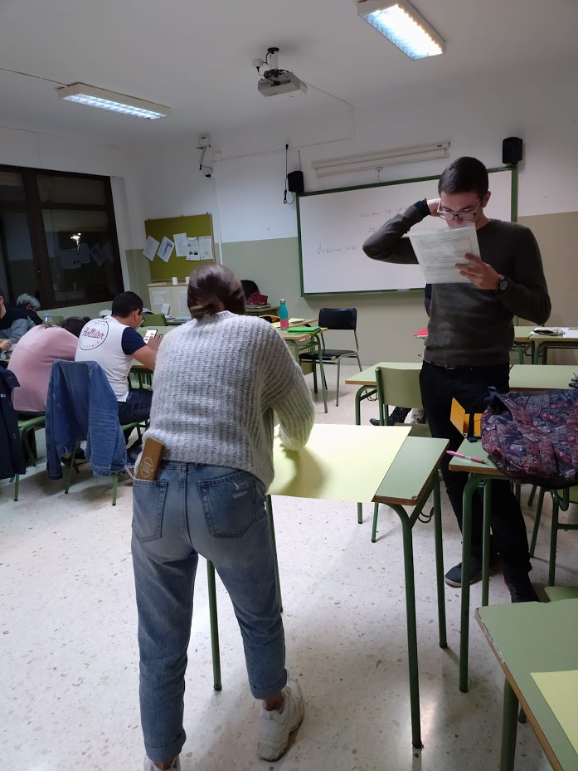
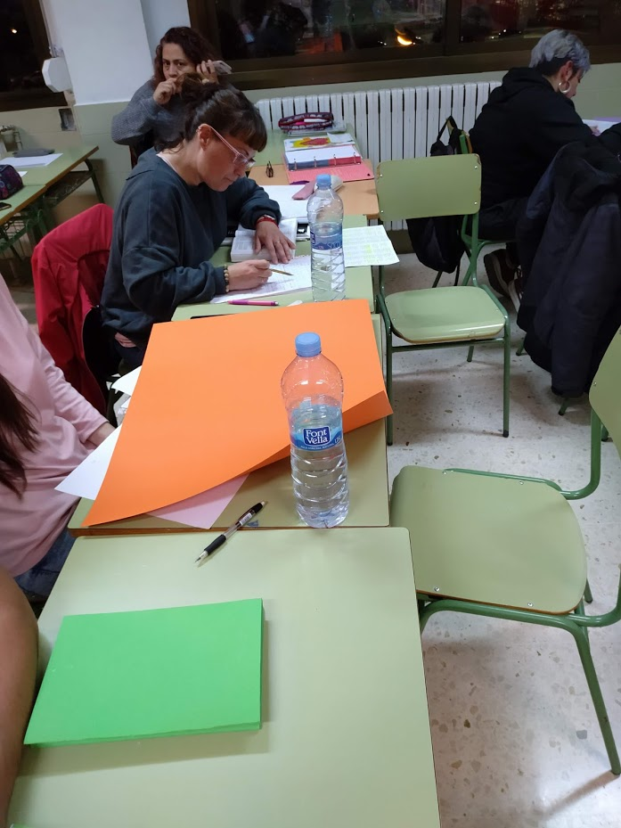
Workshops pictures

Slide 16
How was data gathered?
Two questionnaires in Google forms.
  1st q. – Assessing their reading habits and attitudes/expectations towards the project
  2nd q.– Their opinions and feedback.
Personal teacher’s journal
Their projects and projects’ grades

Slide 17
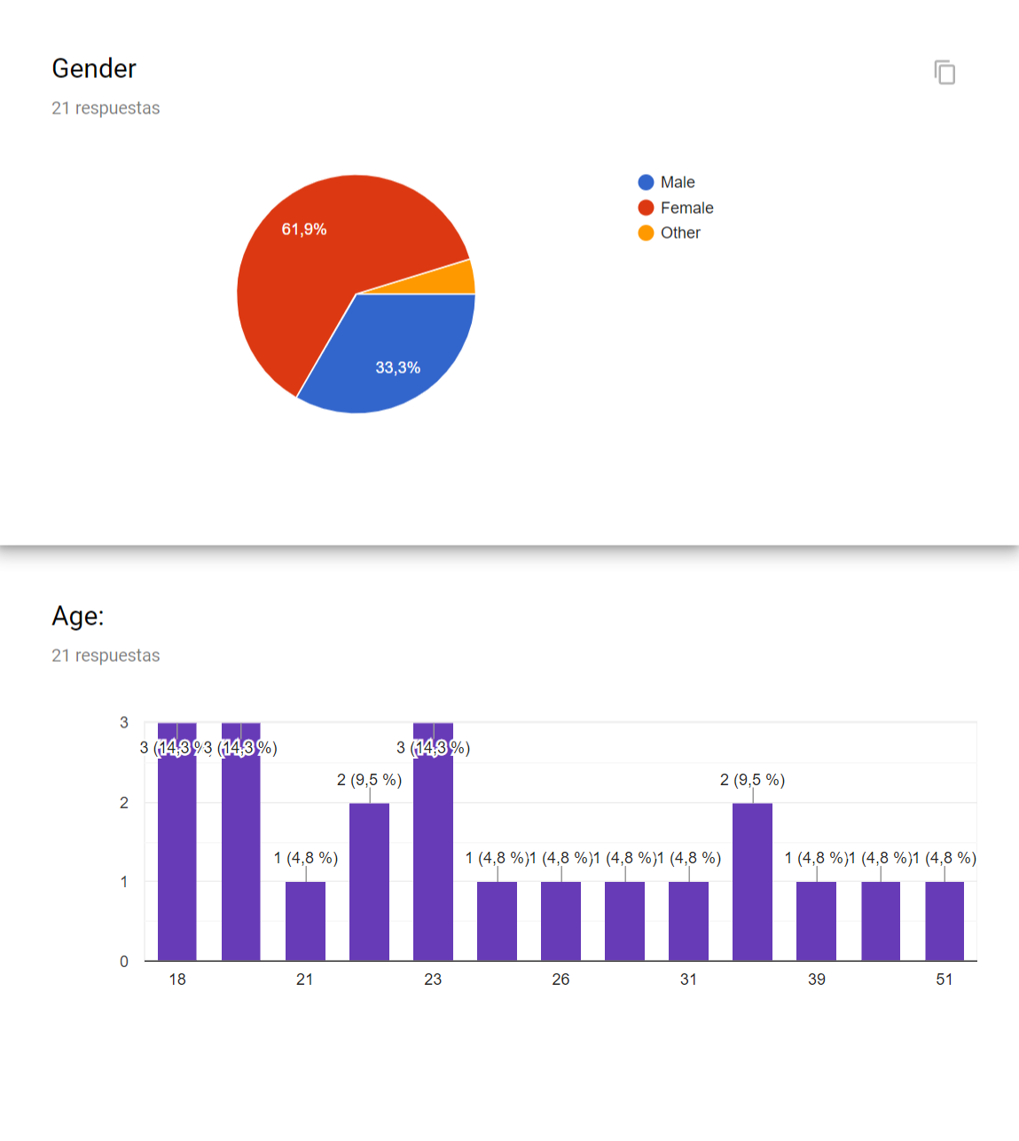
Age and gender

Slide 18
Q1. Reading habits and expectations (i)
81% claim not to read in English. Only 14% claim to enjoy reading in English.
However, they do recognise the importance of reading:
  81% of students do recognise the importance of reading, in any language
  71,4% considered they should read more in English
  52,4% believed reading would improve their English

Slide 19
Q1. Reading habits and expectations (iI)
80% showed motivation about the project
65% opined it would improve their writing skills
65% believed it could be fun
They did not show particular criticism

Slide 20
Q2 – Project results
90% enjoyed doing the Project
75% felt more confident reading in English
70% felt more confident writing in English
75% felt more motivated about English in general
80% felt inclined to read more of Persepolis and/or any other graphic novel
100% enjoyed reading each other’s project

Slide 21
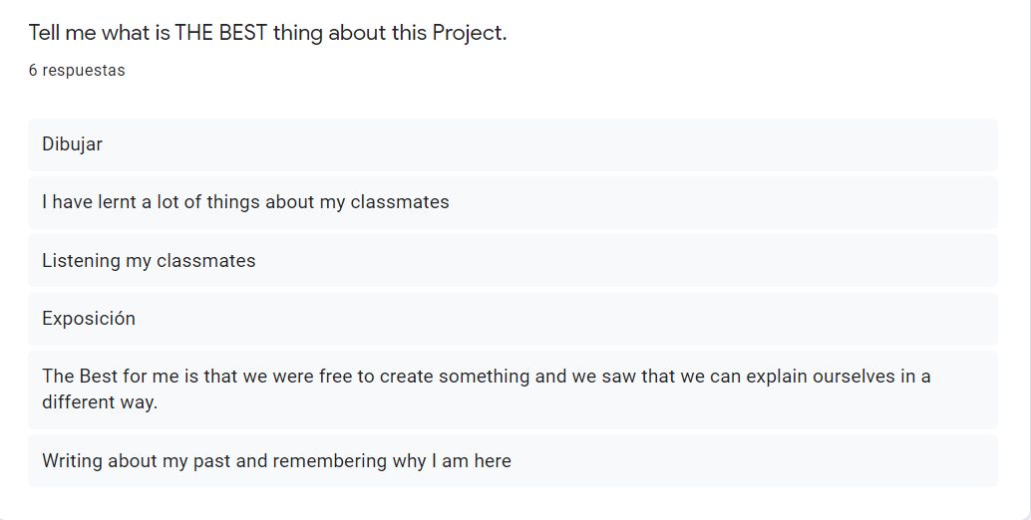

Slide 22
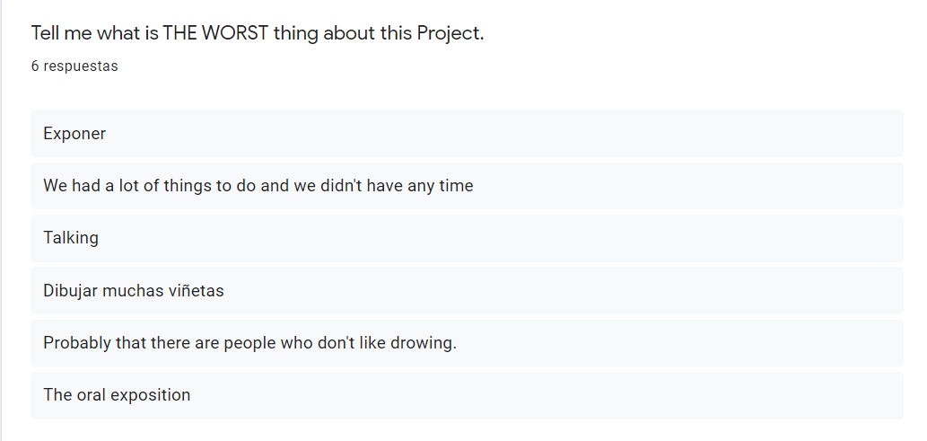

Slide 23
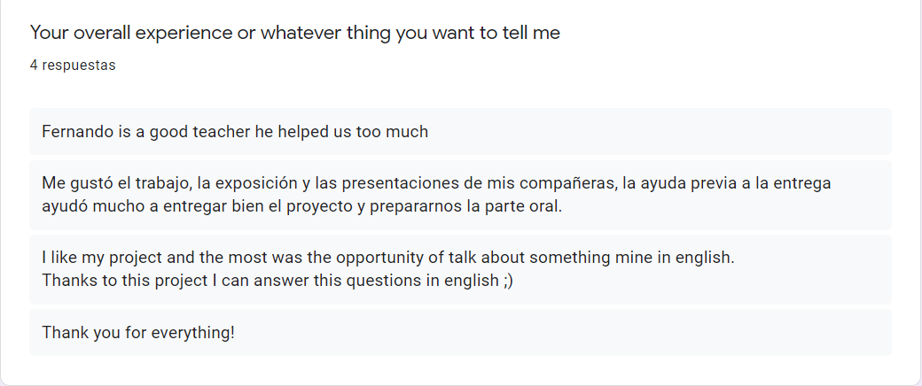

Slide 24
Teacher’s journal
Accounted for a very positive progression among students
- After the presentation of the Project: “they liked it”
- While reading the first chapter of Persepolis: “Maybe too ambitious?”
- After working working on vocabulary, having time ro read in silence, discussing and doing the Kahoot: “they seemed motivated while reading, asked many questions, participated qualititatively and quantitatively, very much enjoyed the Kahoot”
- During the workshops: “they are working very well, they seem motivated”
- “One student did not want to alk about their personal life”
- “Some are quite ahead of the Schedule, some are struggling to finish on time”

Slide 25
Teacher’s journal
During the presentations:
- “They have performed well, with confidence, according to their level and interacting with the public”
- “Thet got emotional and cried”
- “One student felt too nervous and couldn’t deliver (...) eventually they did a good job”

Slide 26
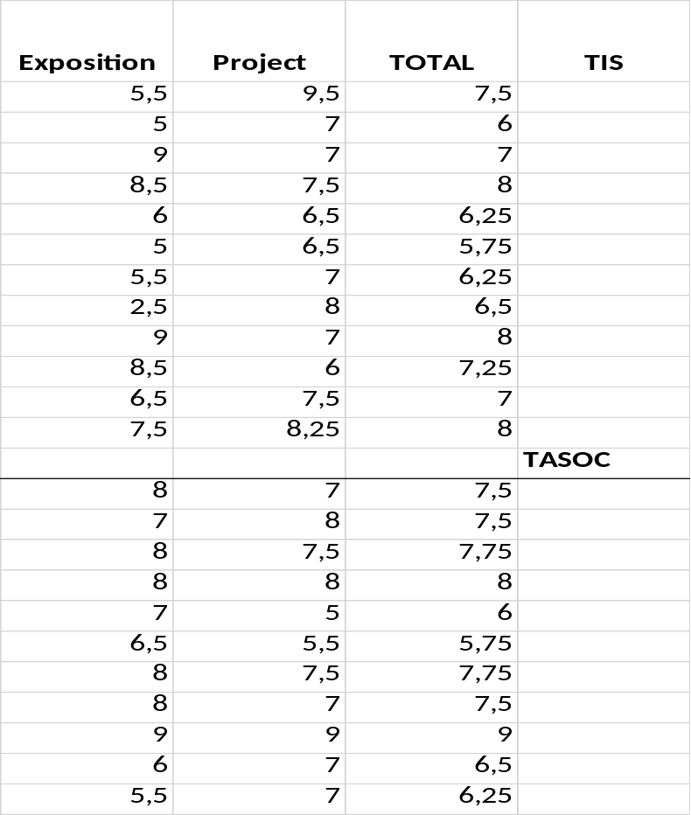
Project results
In the Spanish system 1-10
  5 is a pass
Average grade: 7,1
Assessed through a rubric

Slide 27
Assessment
project
Oral exposition
 | Unsatisfactory. Does not meet expectations. | Needs improvement. Below expectations | Good enough. Accomplished. Meets expectations. | Good. Above expectations | Perfect, exemplary. Far beyond expectations.
1. Creativity, originality and imagination.
2. Writing accuracy, correct use of vocabulary and grammar tenses.
3. Matching use of the drawings with the text.
4. Literary beauty (use of metaphors, depth of the text…).
 | Unsatisfactory. Does not meet expectations. | Needs improvement. Below expectations | Good enough. Accomplished. Meets expectations. | Good. Above expectations | Perfect, exemplary. Far beyond expectations.
1. Speaks without reading support.
2. Proper use of grammatical tenses and vocabulary.
3. Pronunciation and intonation.
4. Ability to answer to improvised questions.

Slide 28
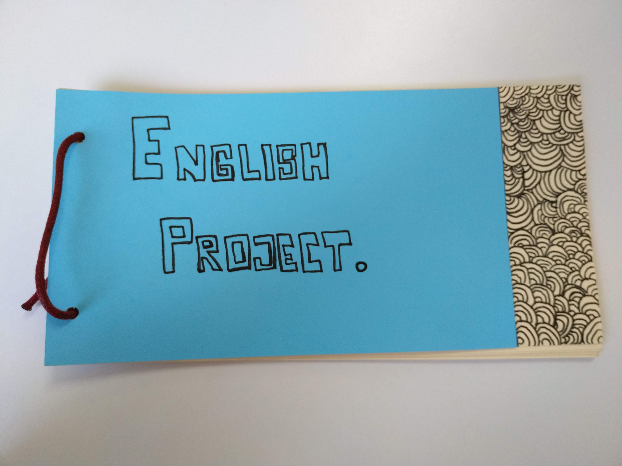
Some projects

Slide 29
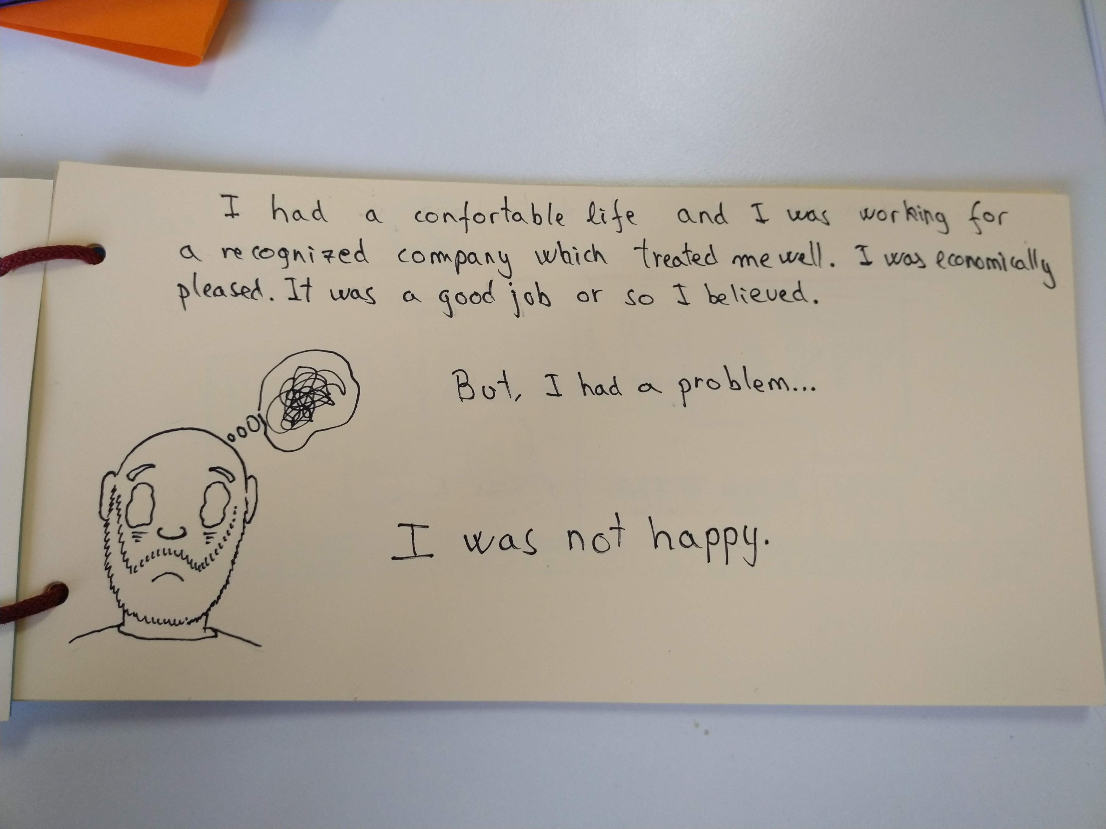

Slide 30
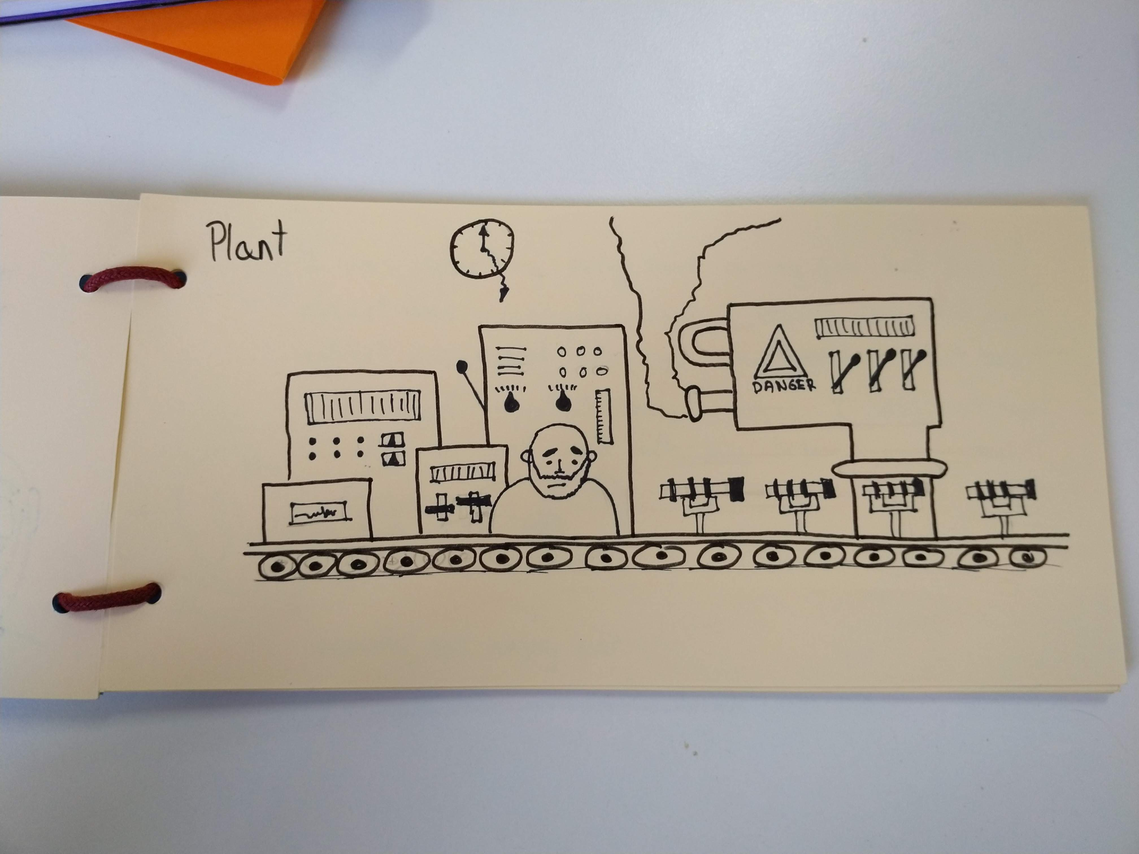

Slide 31
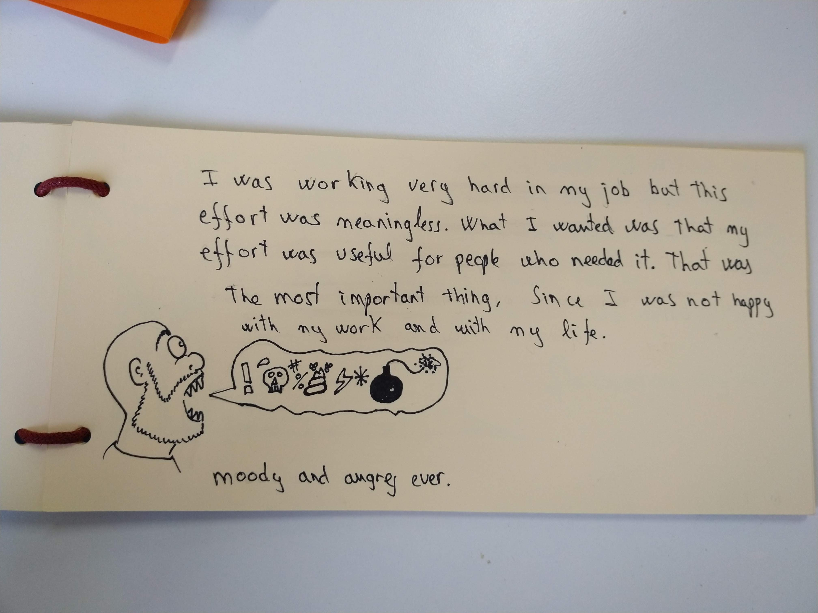

Slide 32
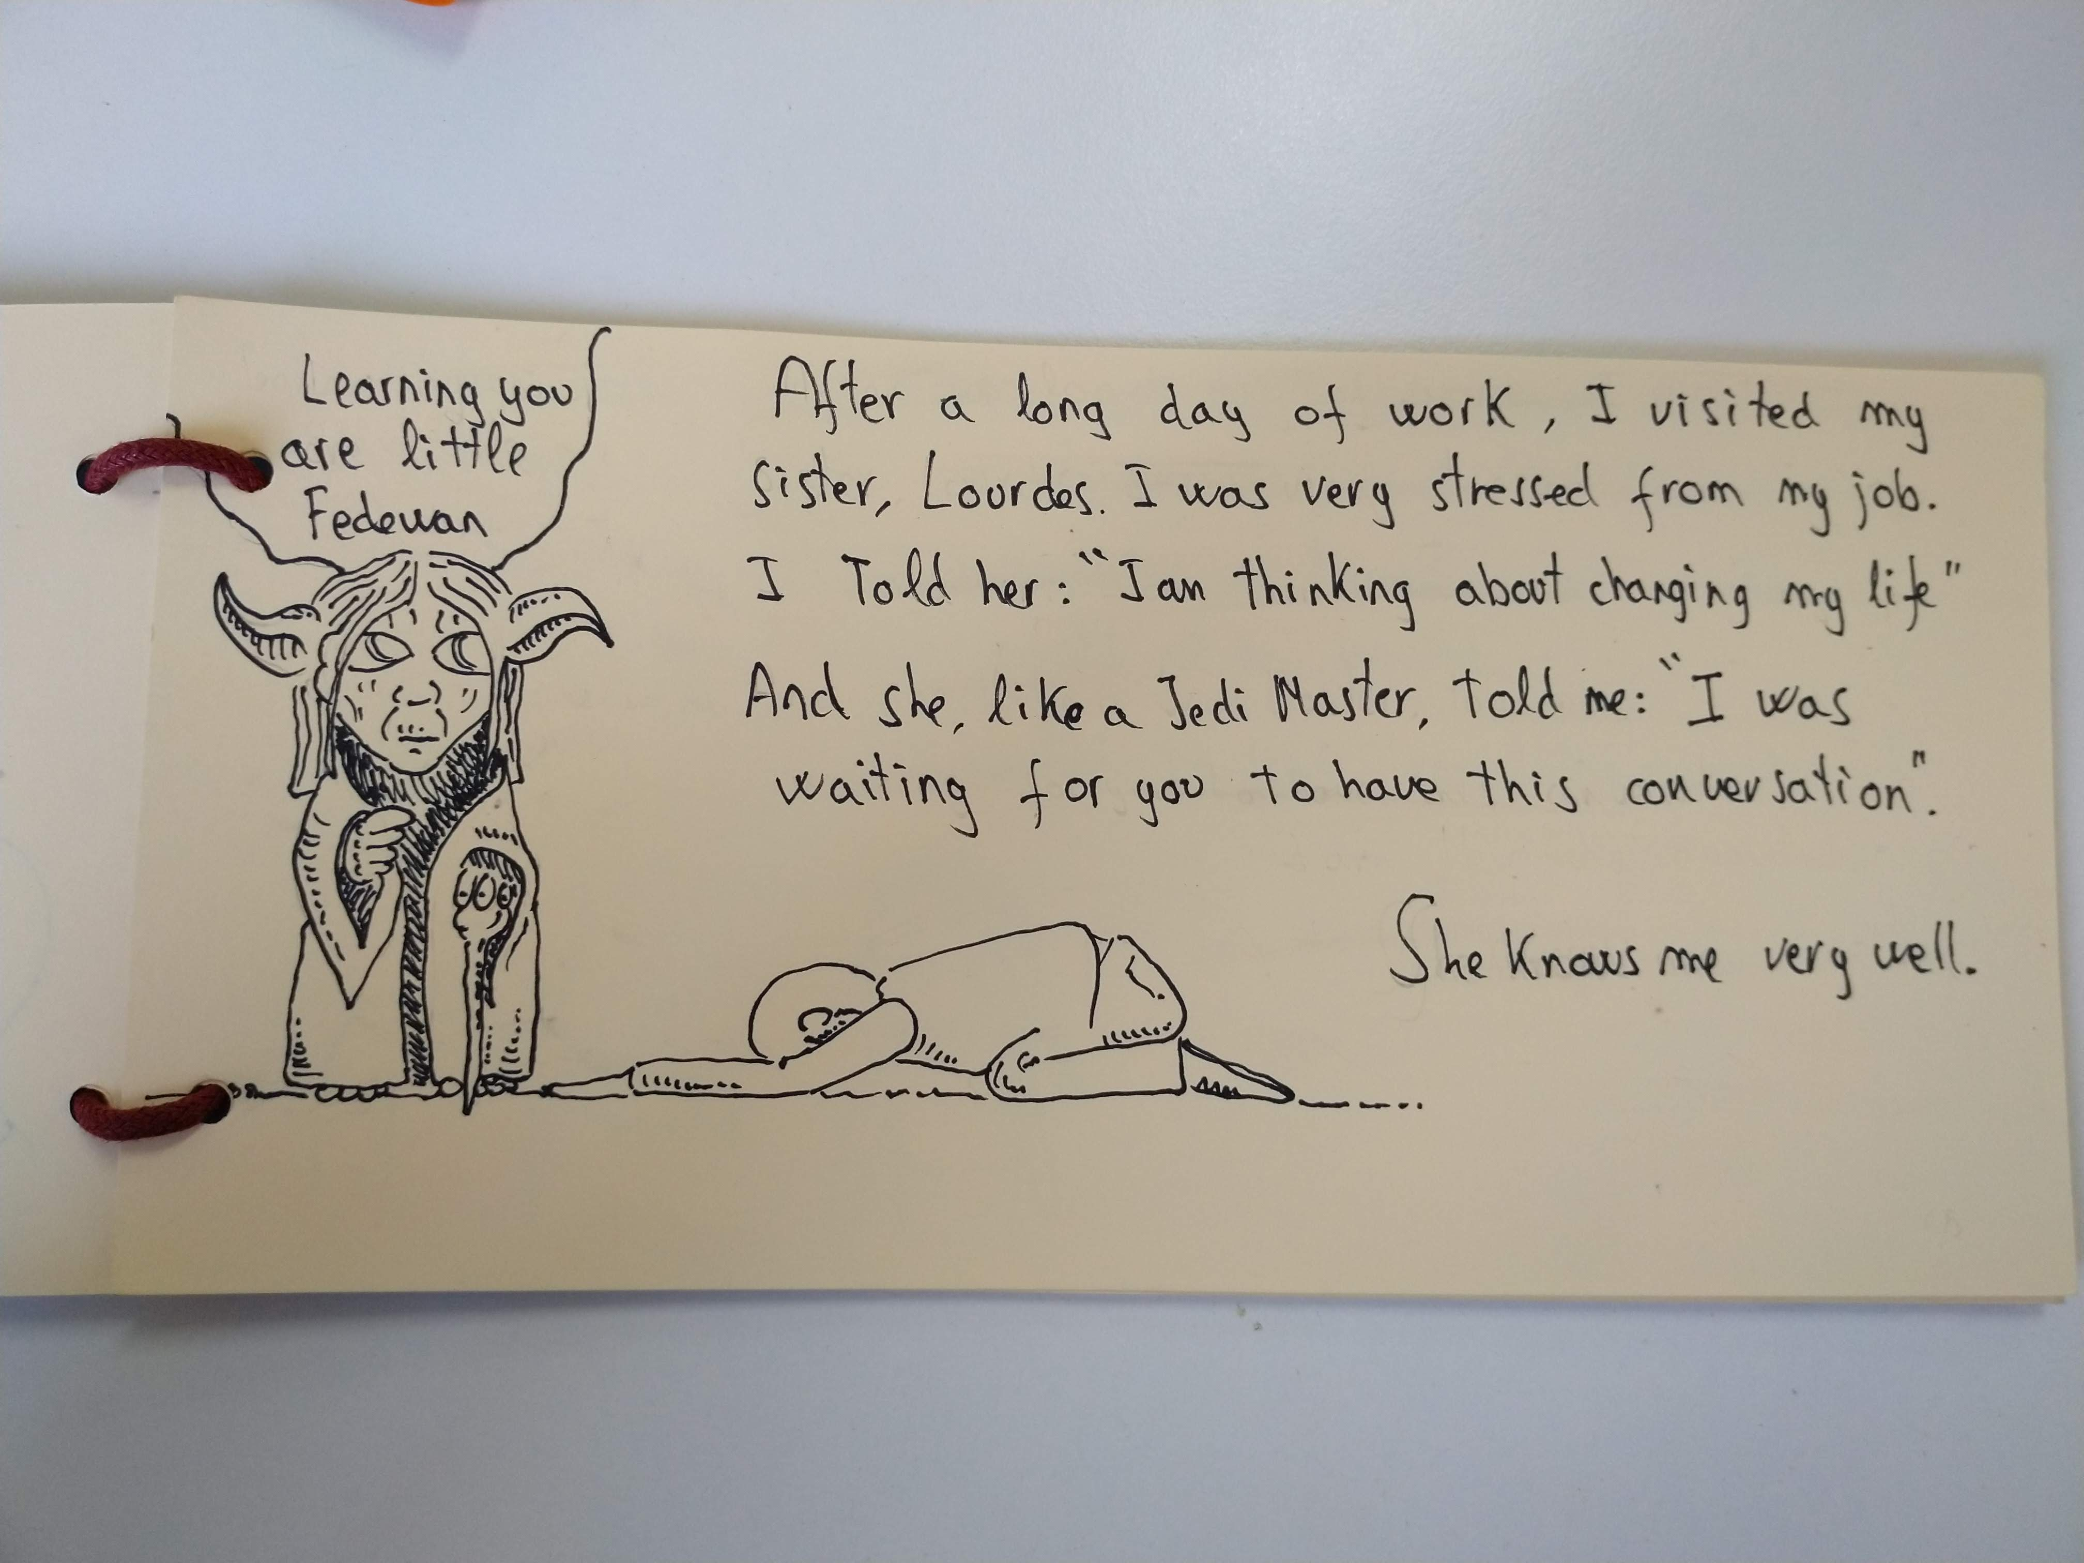

Slide 33
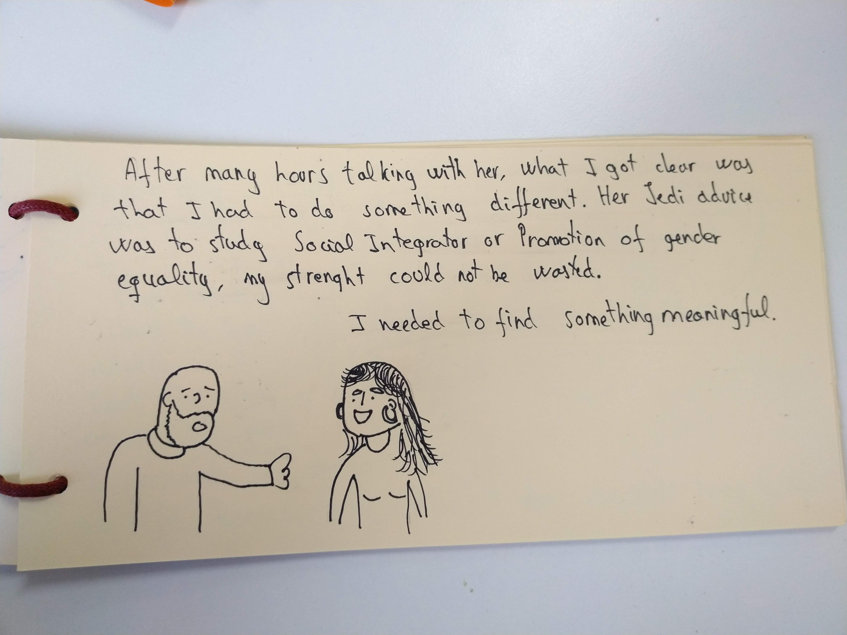

Slide 34
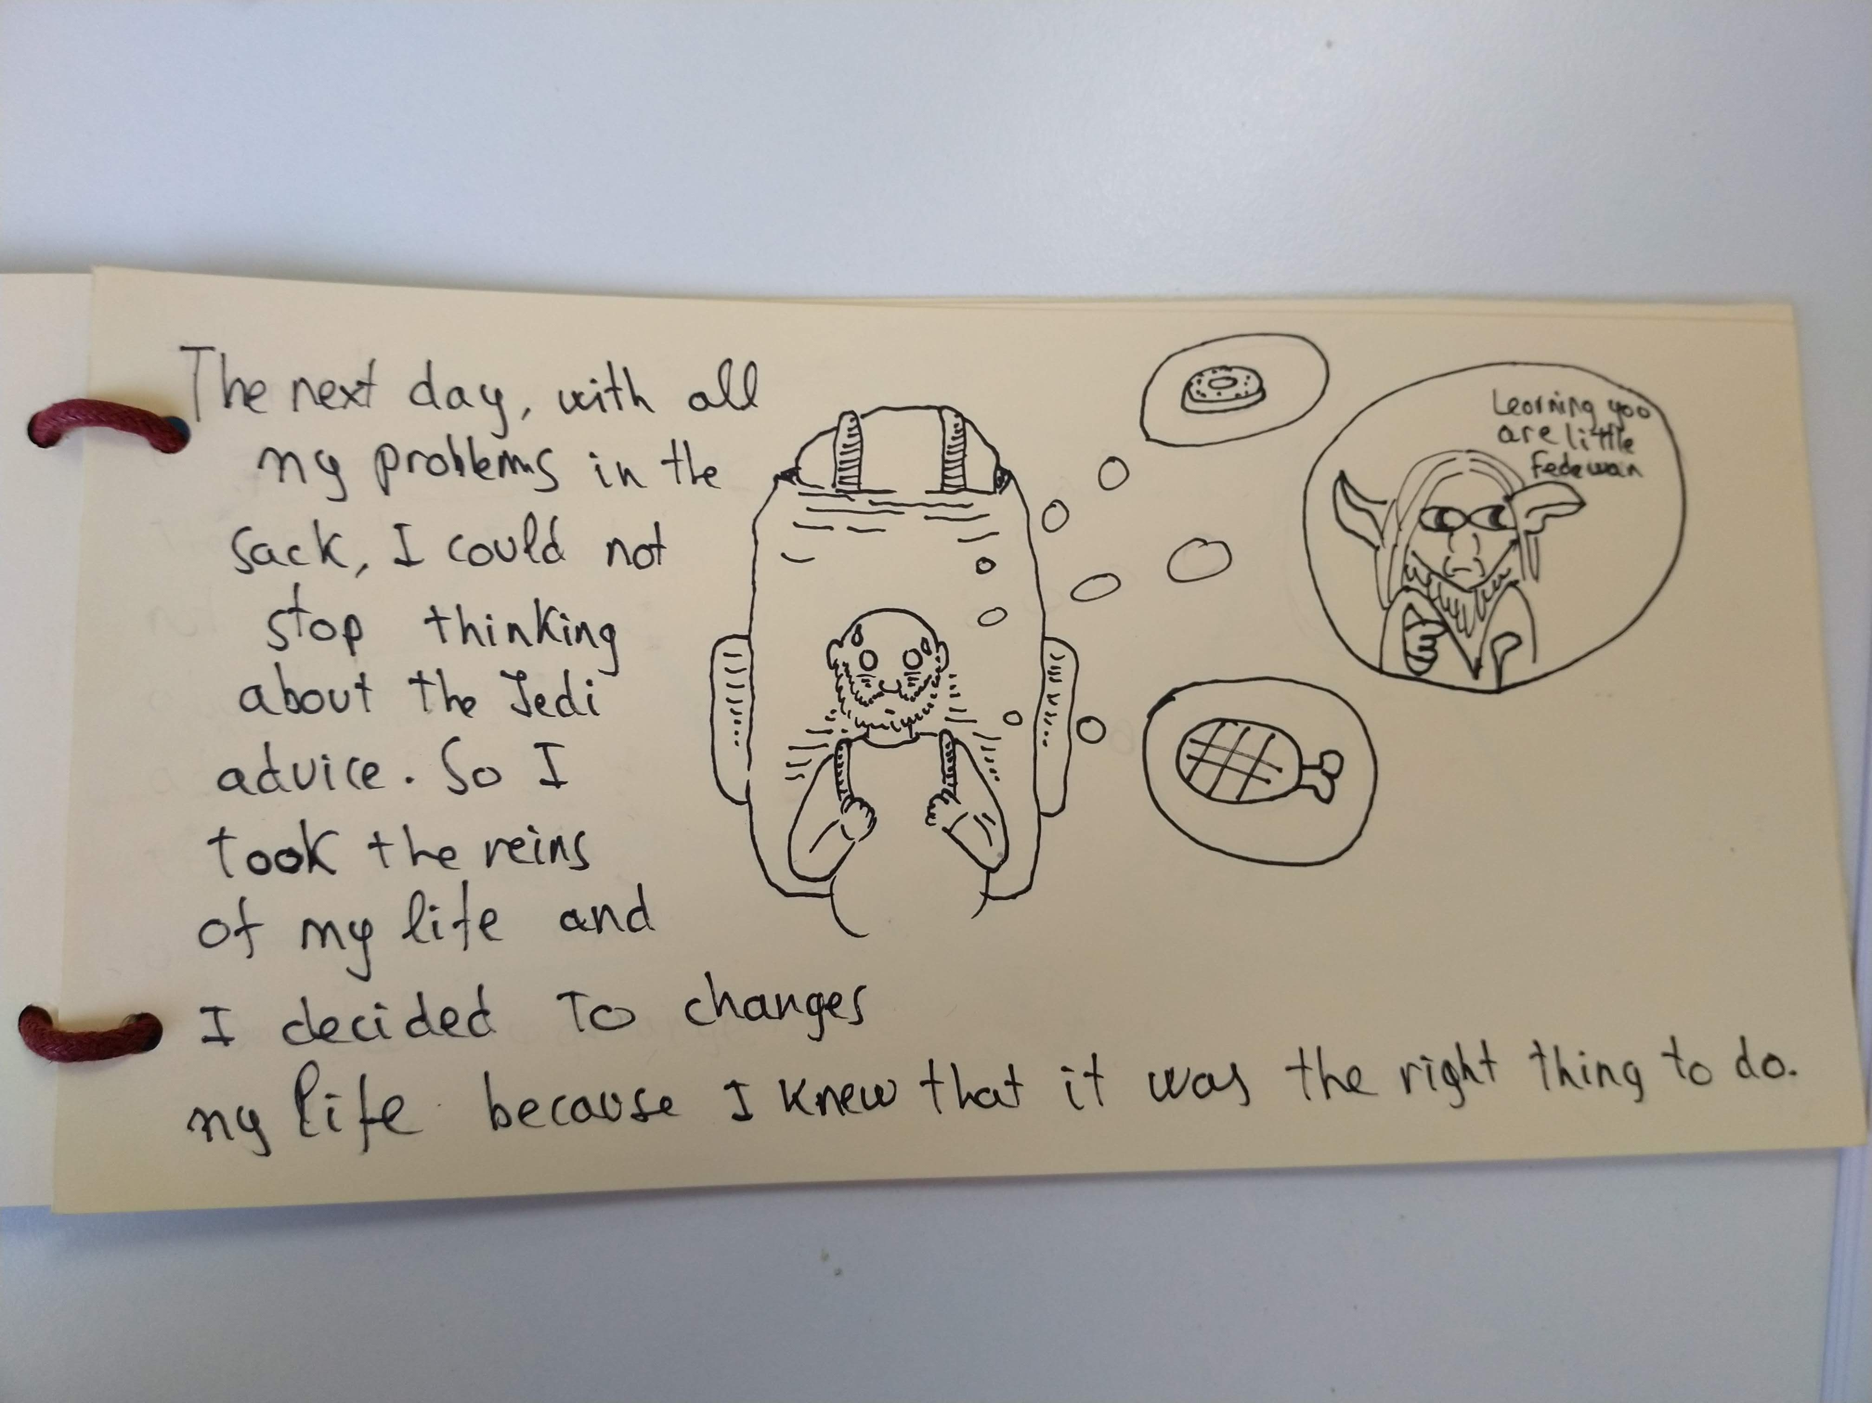

Slide 35
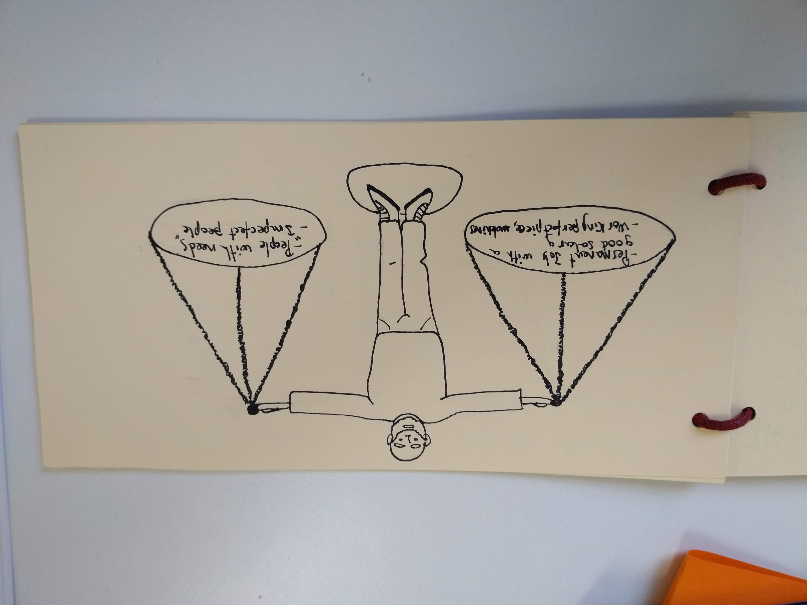

Slide 36
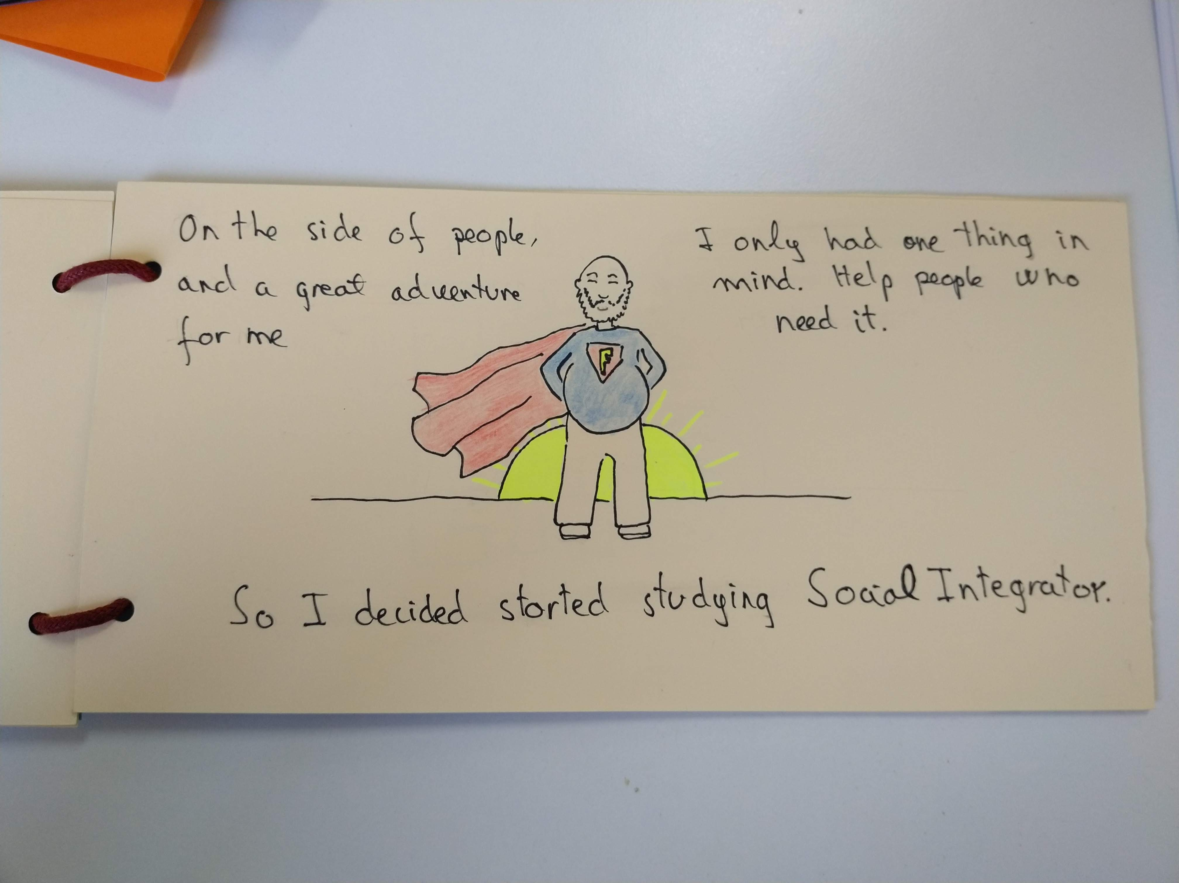

Slide 37
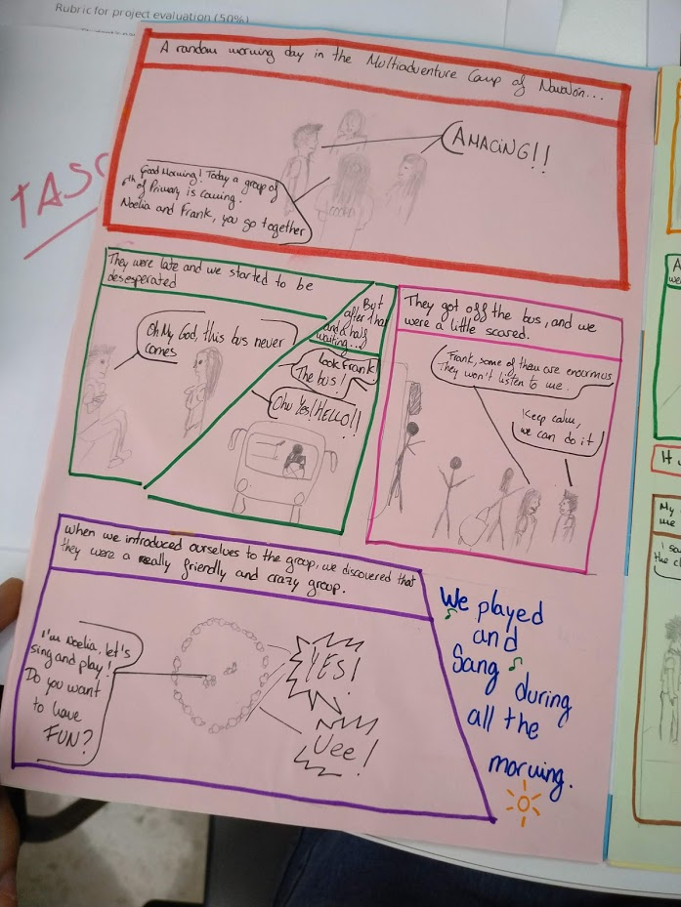

Slide 38
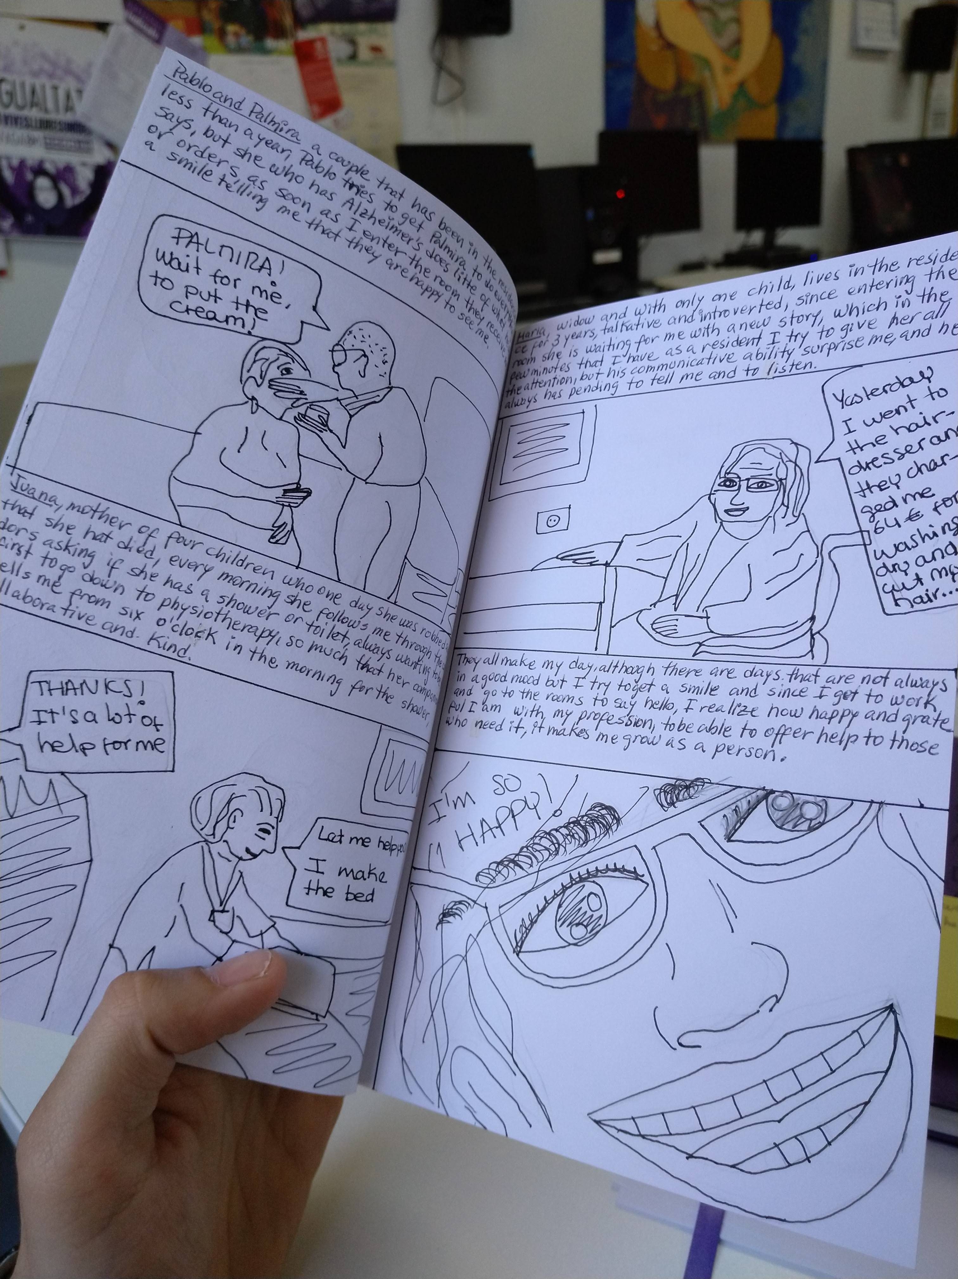

Slide 39
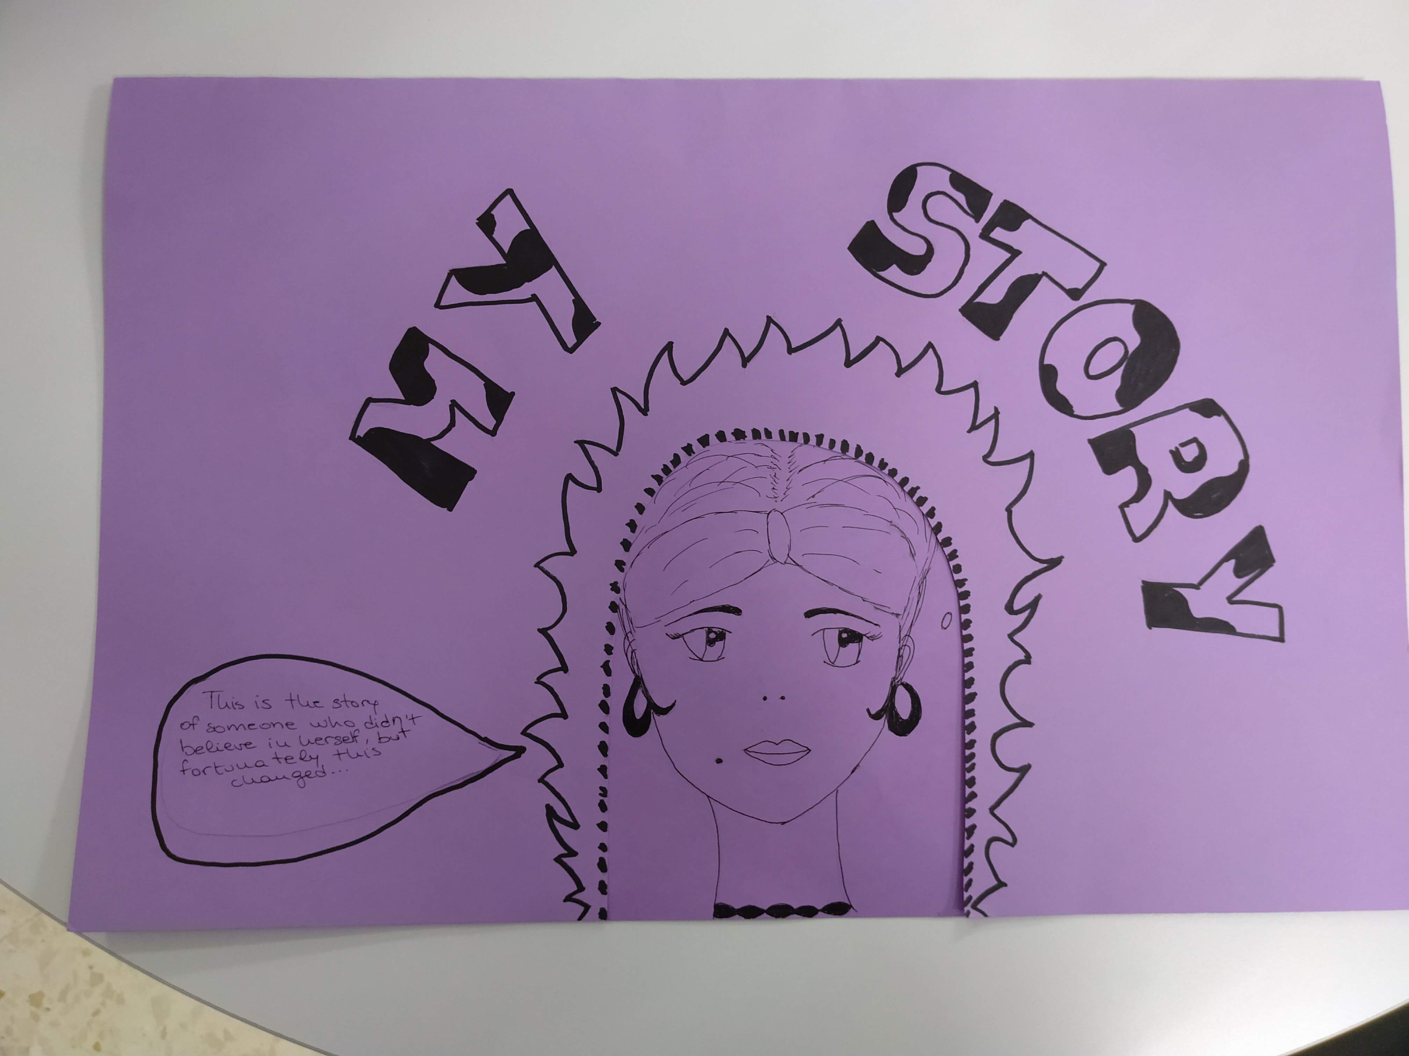

Slide 40
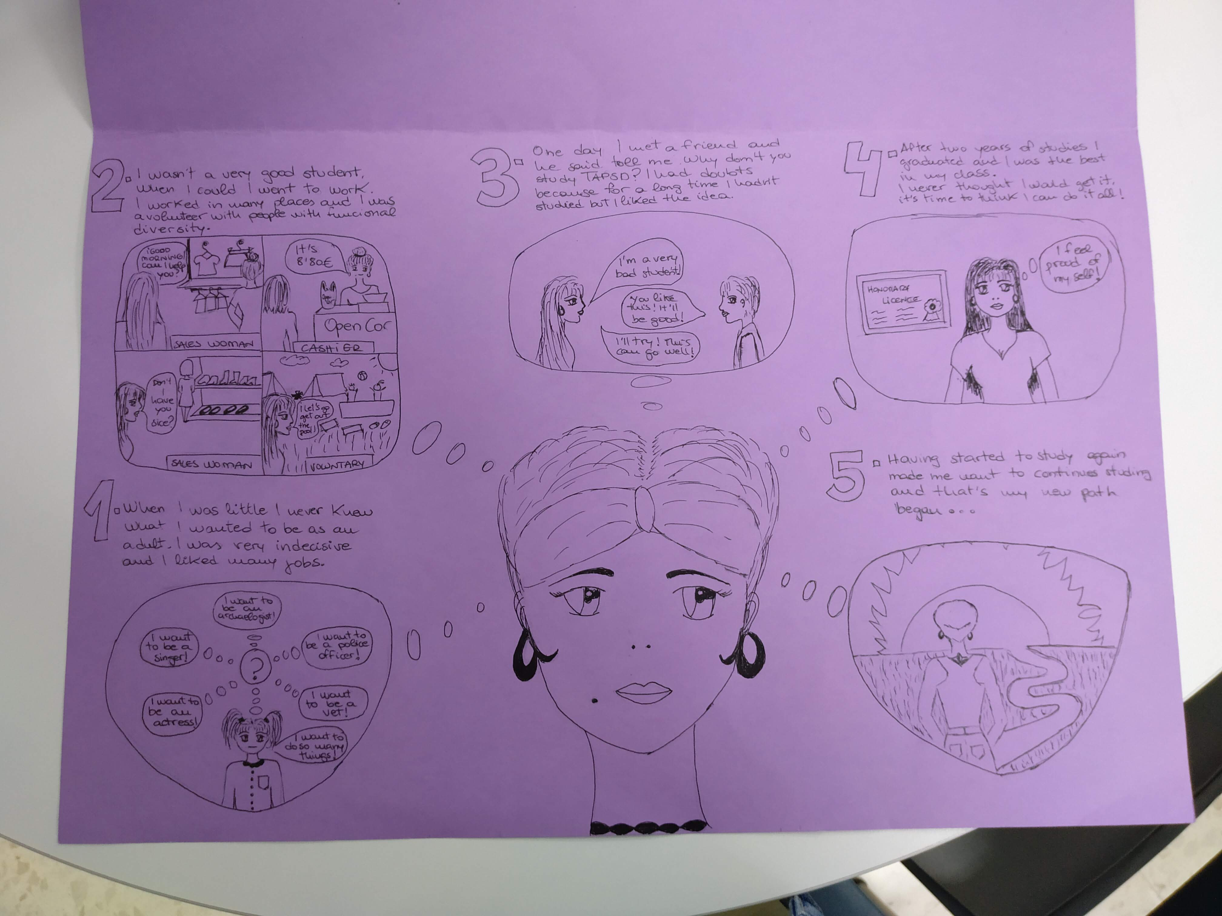

Slide 41
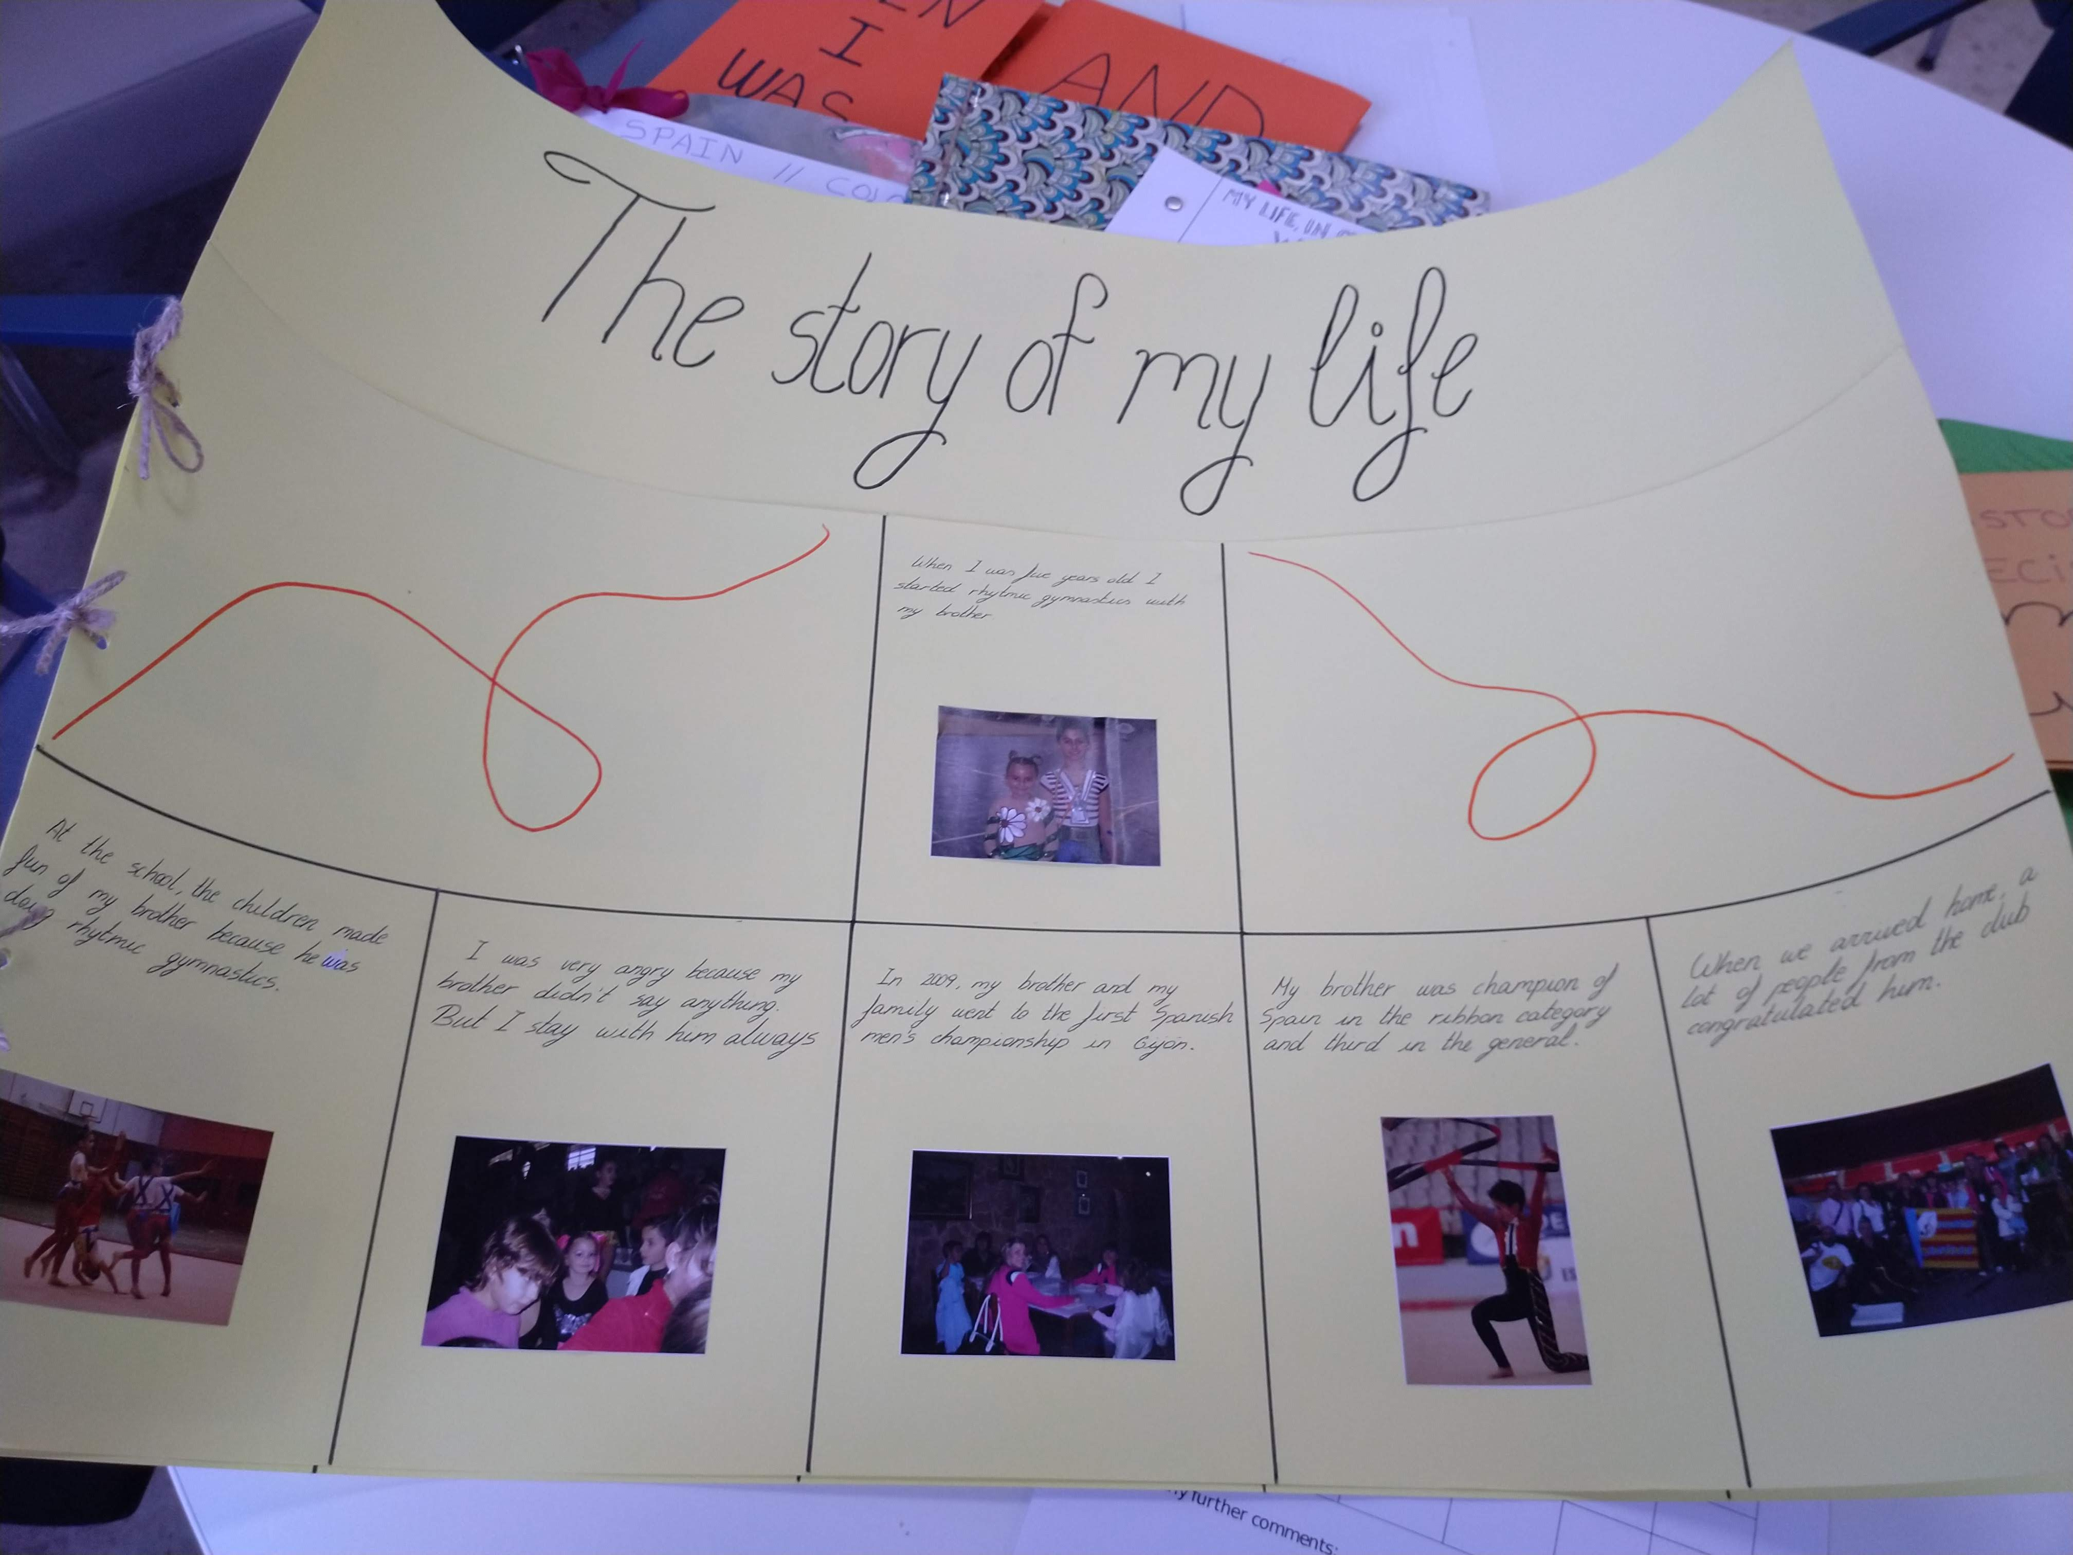

Slide 42
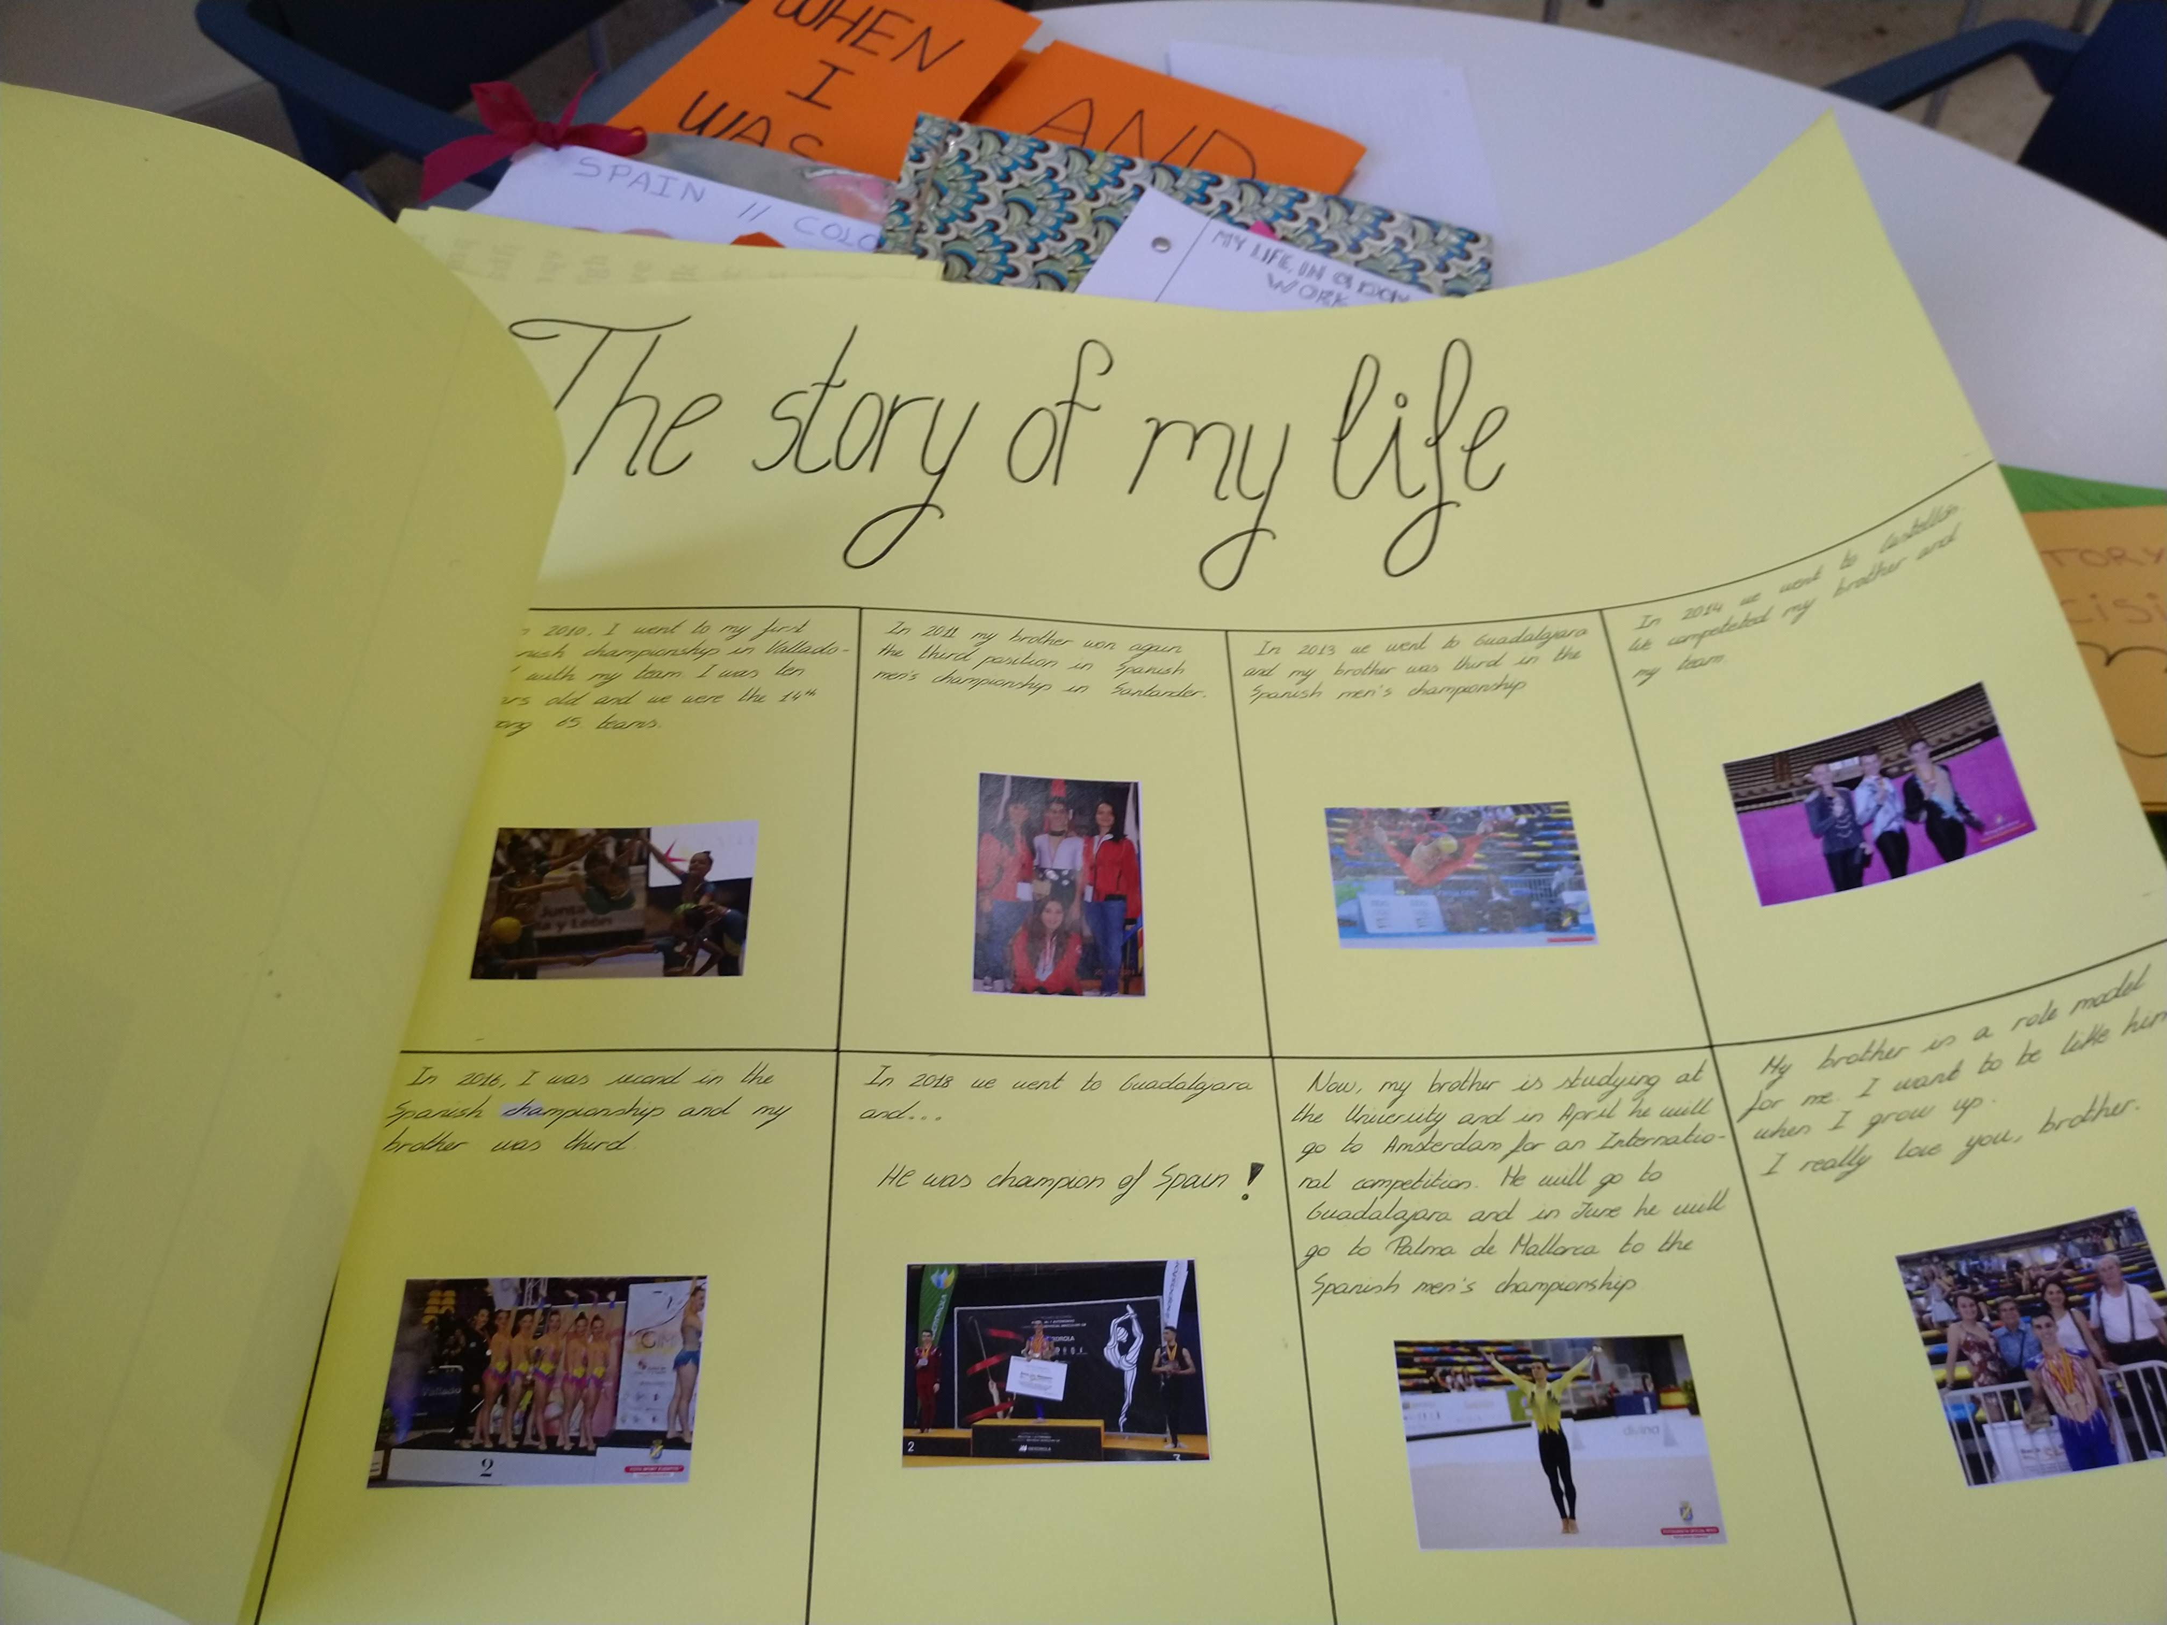

Slide 43
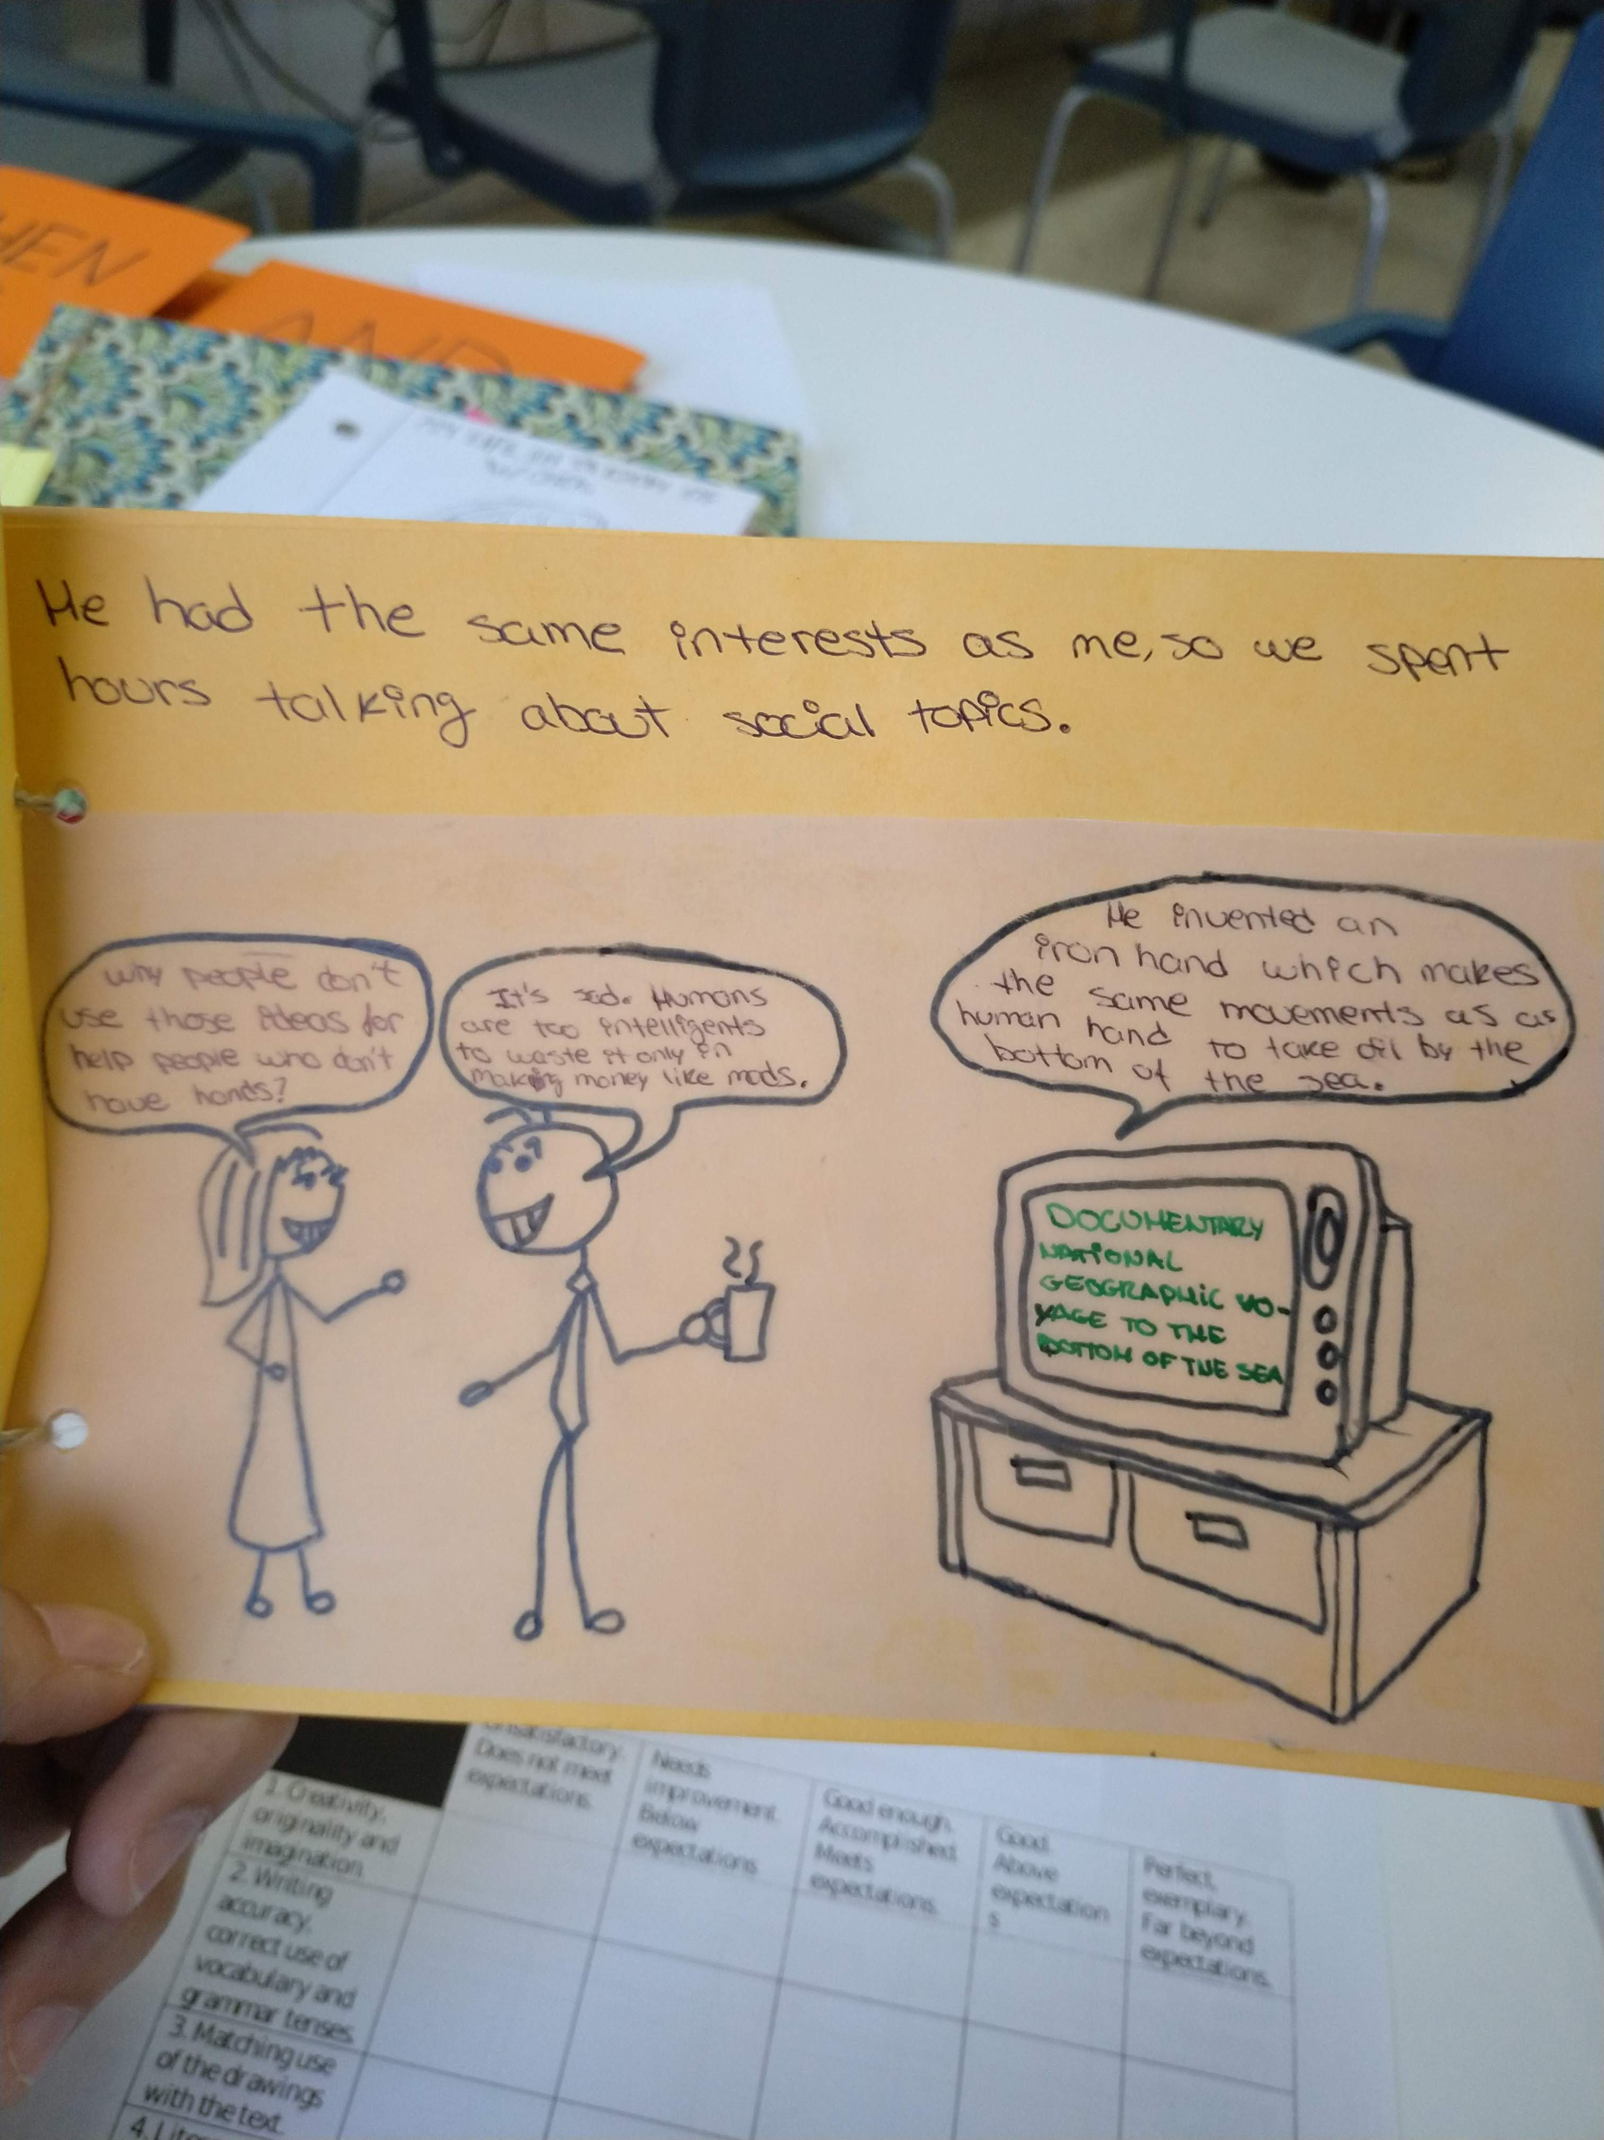

Slide 44
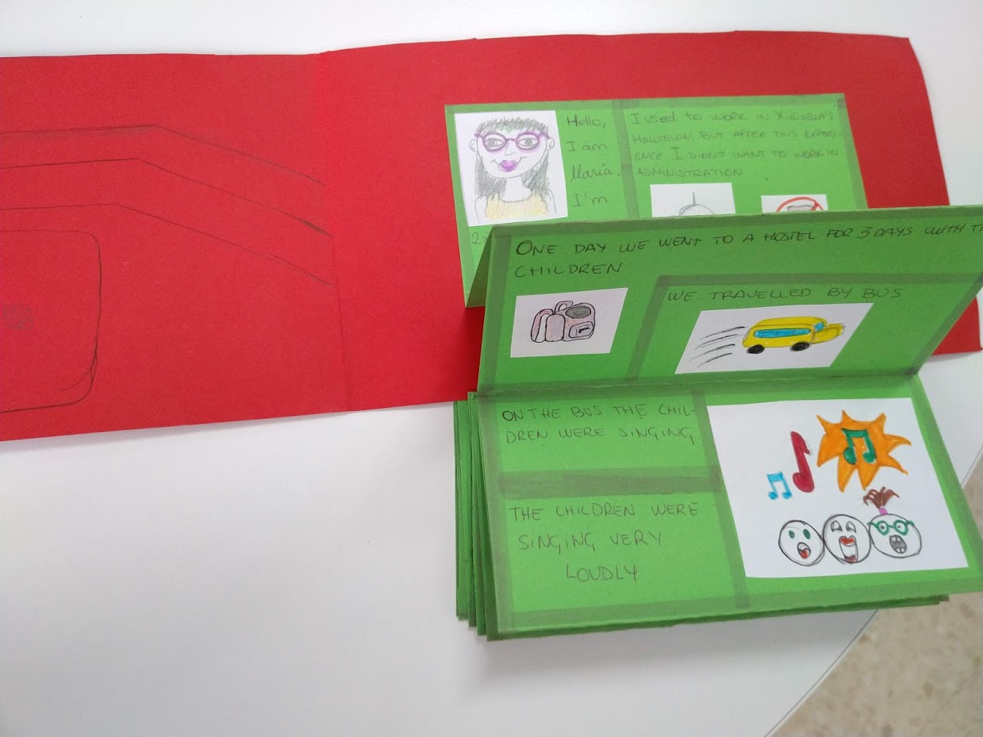

Slide 45
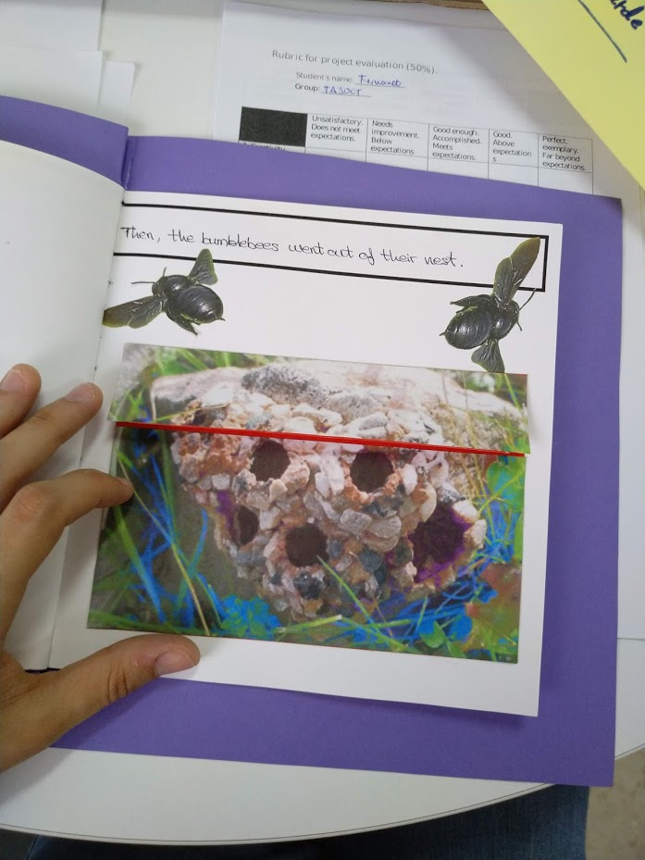
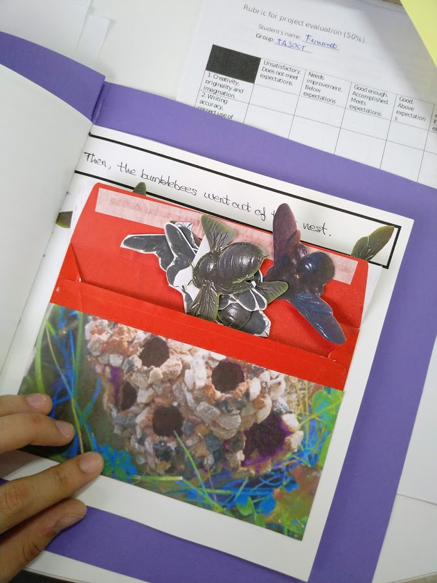

Slide 46
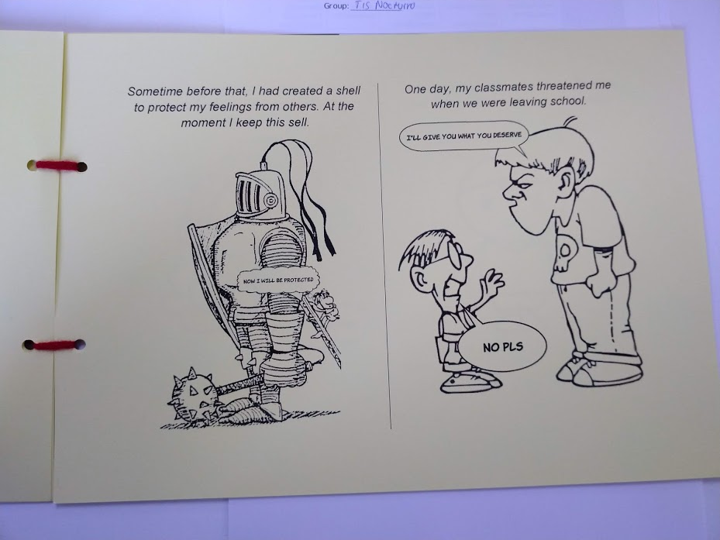

Slide 47
Reflections
Problems
The oral presentation was a problem
Constrains due to curriculum
Small study – only 23 people
Adapting it to Covid-19 times – computer literacy?
Successes
Giving students freedom to express themselves creatively
Students’ reacted well to the reading

Slide 48
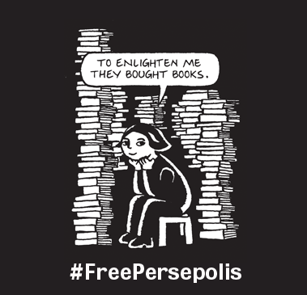
Conclusions
Working with literature in the MFL classroom is possible!
Graphic novels are a good resource to use
Combination of multiliteracy and creative writing engaged and motivated students
Acknowledging “multiplicity of discourses” had an important role in the project
Giving them space and freedom to express themselves motivated and affected their attitude towards the poject.

Slide 49
References
CLAVEL ARROITIA, B., 2012. Second Language Acquisition and Teaching English as a Foreign Language . Valencia: Publicacions Universitat de Valencia.
LANGUE-GUERRA, M., 2017. Understanding the Use of Graphic Narratives through Multiliteracies Approach: A Study of the Use of Persepolis as a Multimodal Instrument in EFL/ESL/EL Classroom , Universidad de Jaen.
PAGLIARO, M., 2014. Is a Picture Worth a Thousand Words? Determining the Criteria for Graphic Novels with Literary Merit . The English Journal, 103(4), pp. 31-45.
SERAFINI, F., 2012. Multimodal Literacy: From Theories to Practices . Language Arts, 92(6), pp. 412-423.
WESTBY, C., 2010. Multiliteracies: The Changing World of Communication . Topics in Language Disorders, 30(1), pp. 64-71.

Slide 50
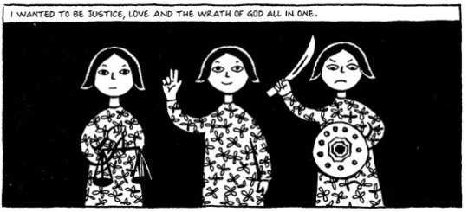
Any questions?
fec16@aber.ac.uk

